Slide 1

Spring 2024
Affordable Learning Solutions Workshop
Ali Dehghan

Slide 2
Introduction
Faculty: Ali Dehghan, Adjunct Professor of IT
Course: SCM 4750: Supply Chain Analytics
Course type: Online and synchronous
Course description:.
Comprehensive practice of the Business Analytics process, including forecasting, data extraction and mining, analytical modeling, detailed analysis, and reporting utilizing business cases. Formerly offered as SCM 475. Semester Prerequisite: ADMN 2100. Quarter Prerequisite: IST 274.

Slide 3
Adaptations with AL$ Project
New course: If traditionally taught without AL$ implementation
  Due to the interdisciplinary nature, it would require multiple textbooks or chapters from various textbooks, making it challenging to find materials.
  Students would need to read textbook chapters, view PowerPoint slides, and complete exercises from different workbooks, which could be confusing.
New course with AL$ implementation
  Fully online, using McGraw-Hills LMS (Connect) which is fully integrated with Canvas
  Fully online simulation platforms

Slide 4
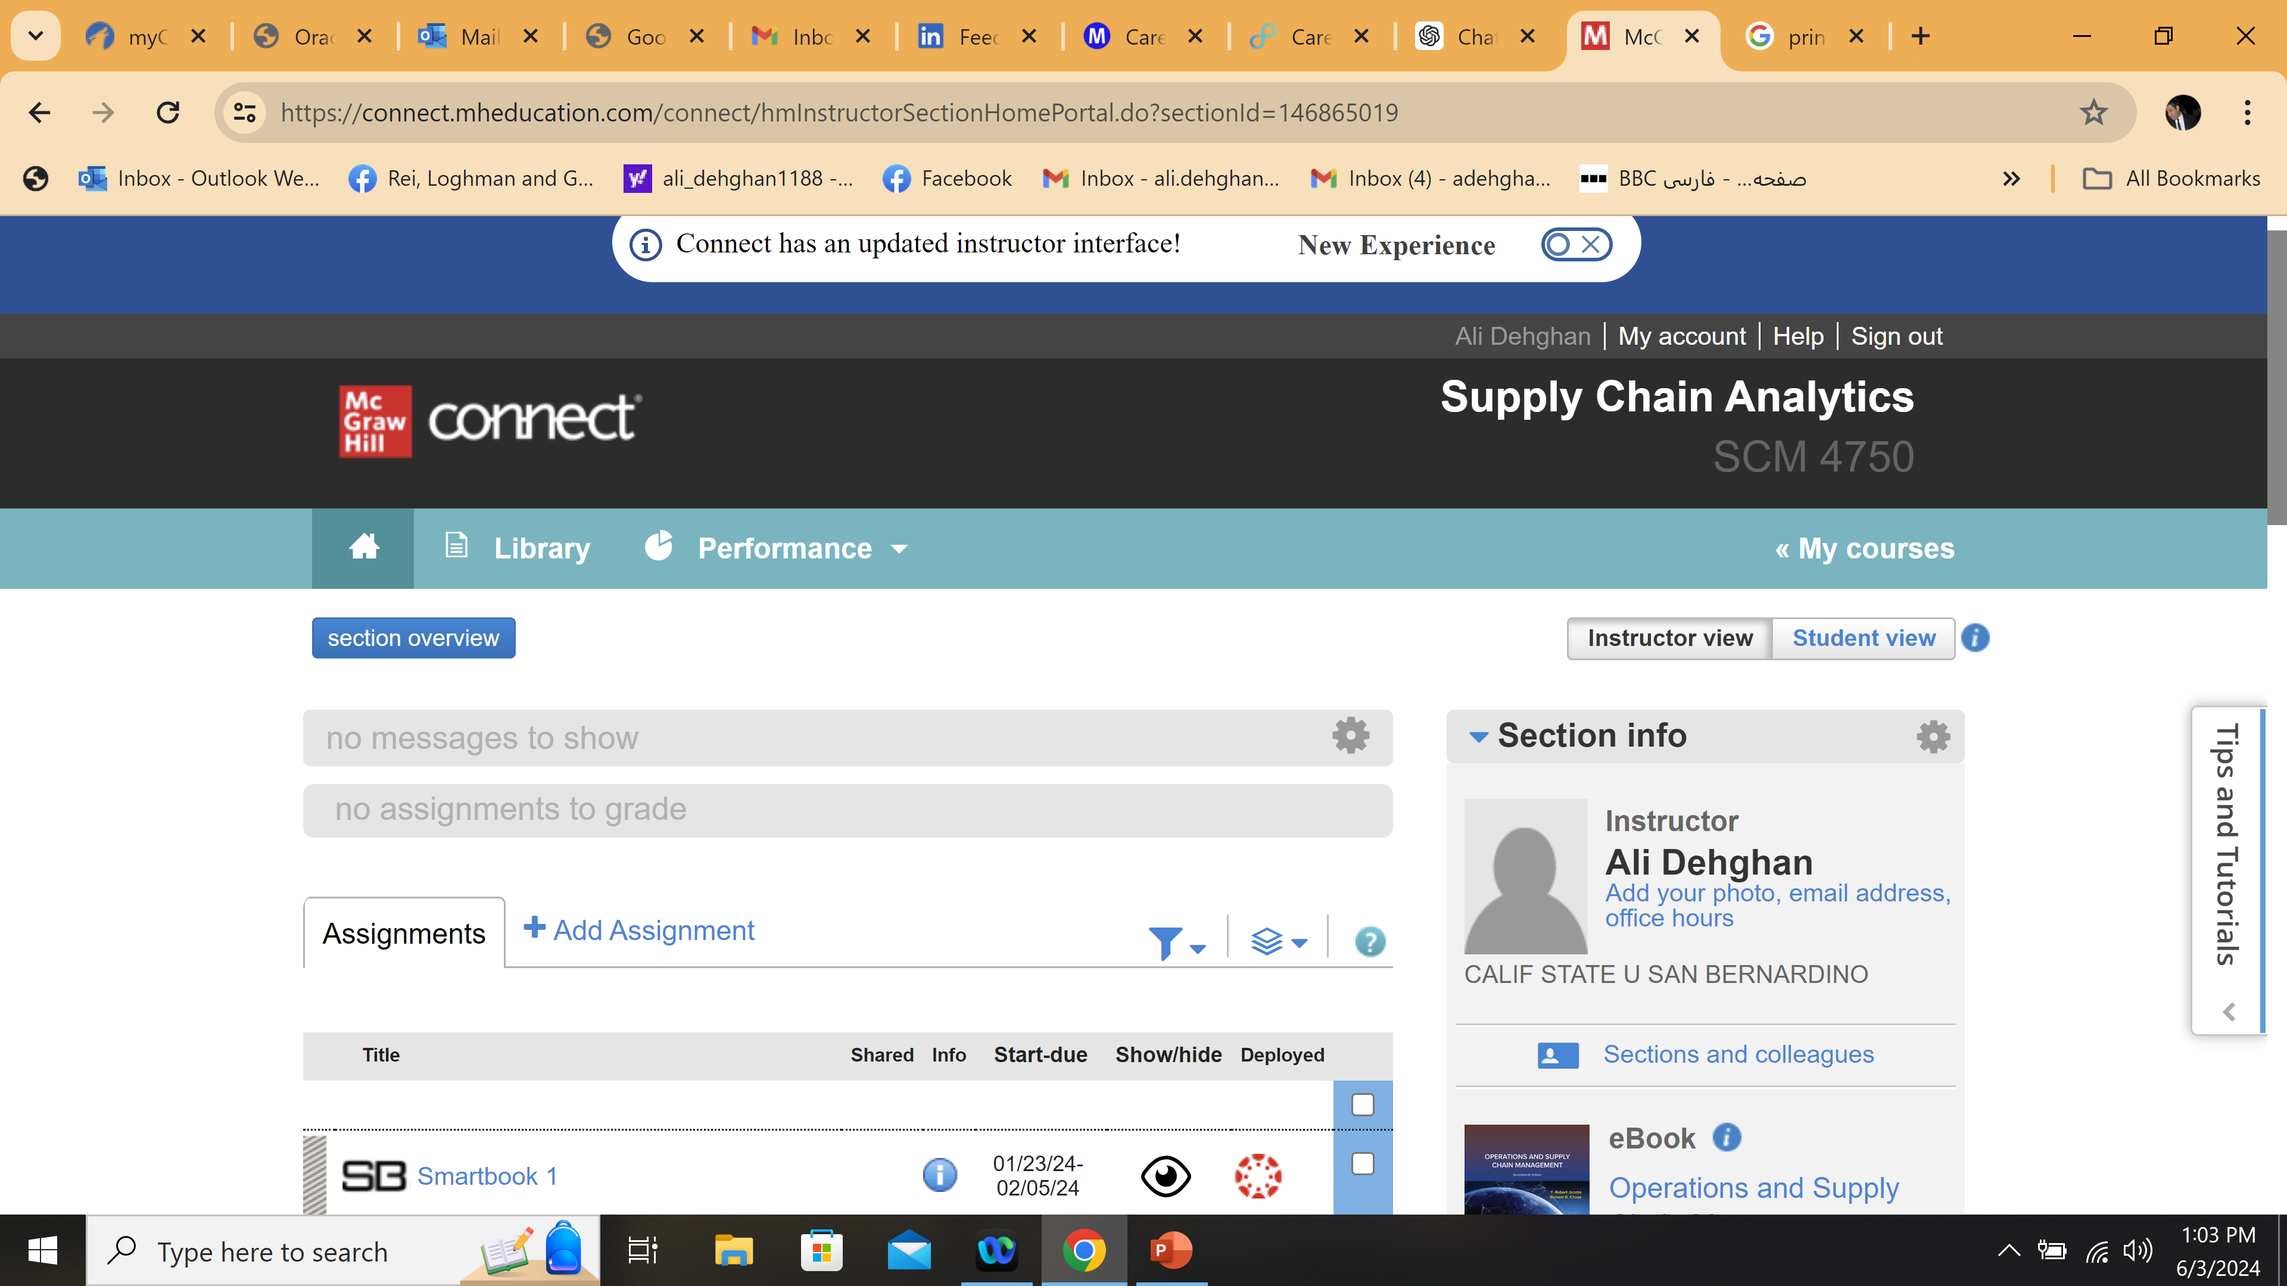
The McGraw Hills LMS integrated with Canvas

Slide 5
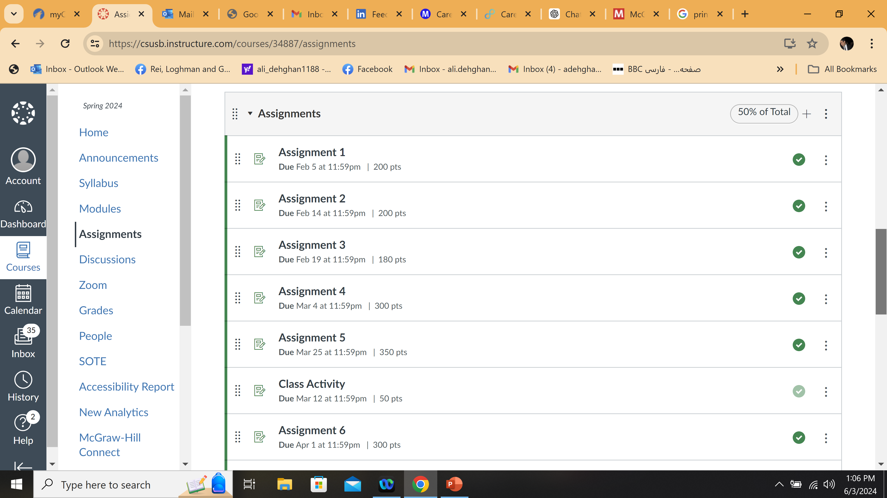
SCM 4750 in Canvas

Slide 6
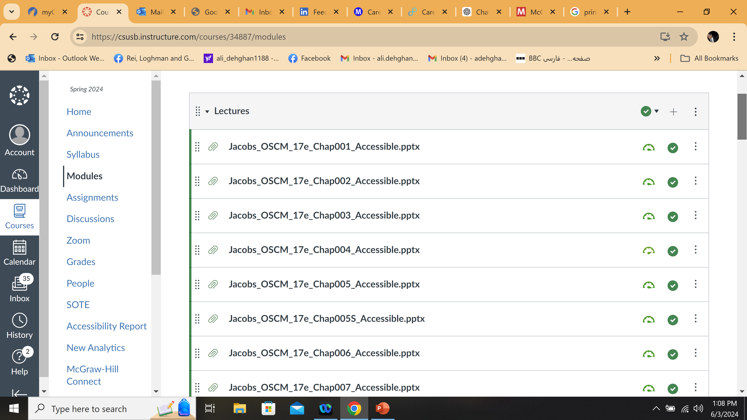
SCM 4750 in Canvas

Slide 7
Experience, Challenges, Successes
Experience : Excellent! The application process is simple and the deliverables are valuable.
Challenges
  Using only 1 book which covers all aspects of the course
  It was so time consuming to build up the course shell
Successes & Resources
  Students paid 30% less
  Great! The application process is straightforward and the deliverables are beneficial.
  Materials available here:
  https://connect.mheducation.com/class/a-dehghan-scm-4750
Savings for students: $60
  Potential textbooks cost: $120

Slide 8
Thank you!

