Slide 1
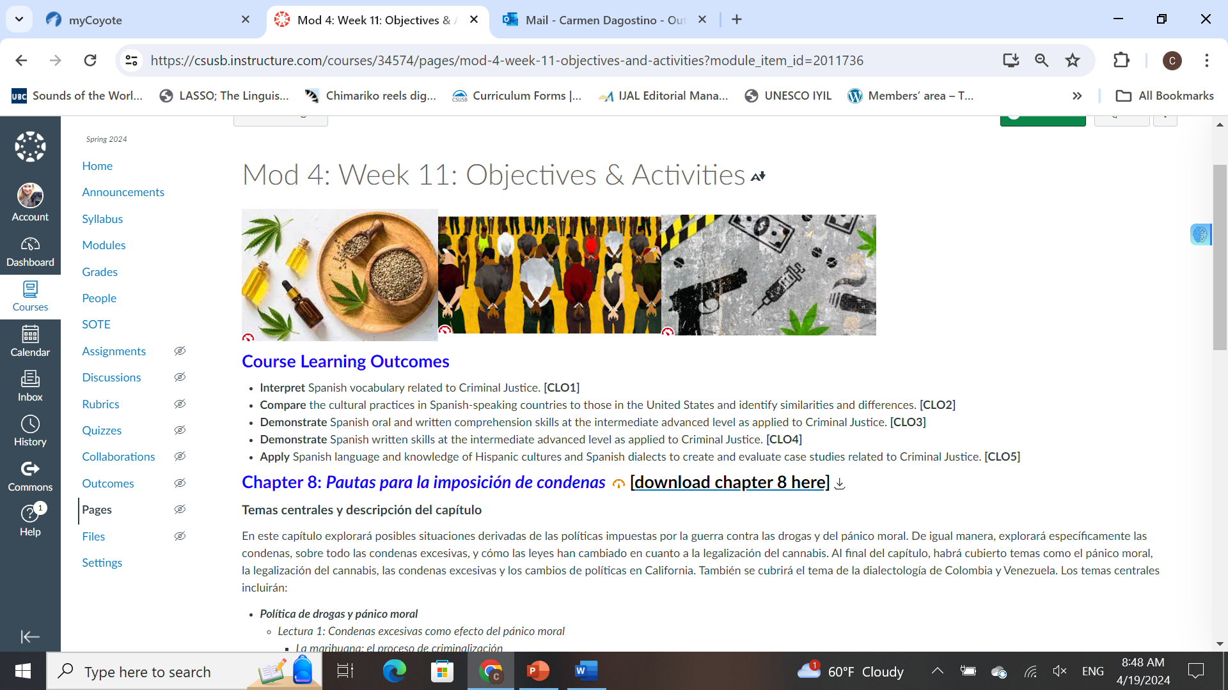
Illustrating Span 3061 in Canvas
QLT design (with alignment of CLOs and MLOs)

Slide 2
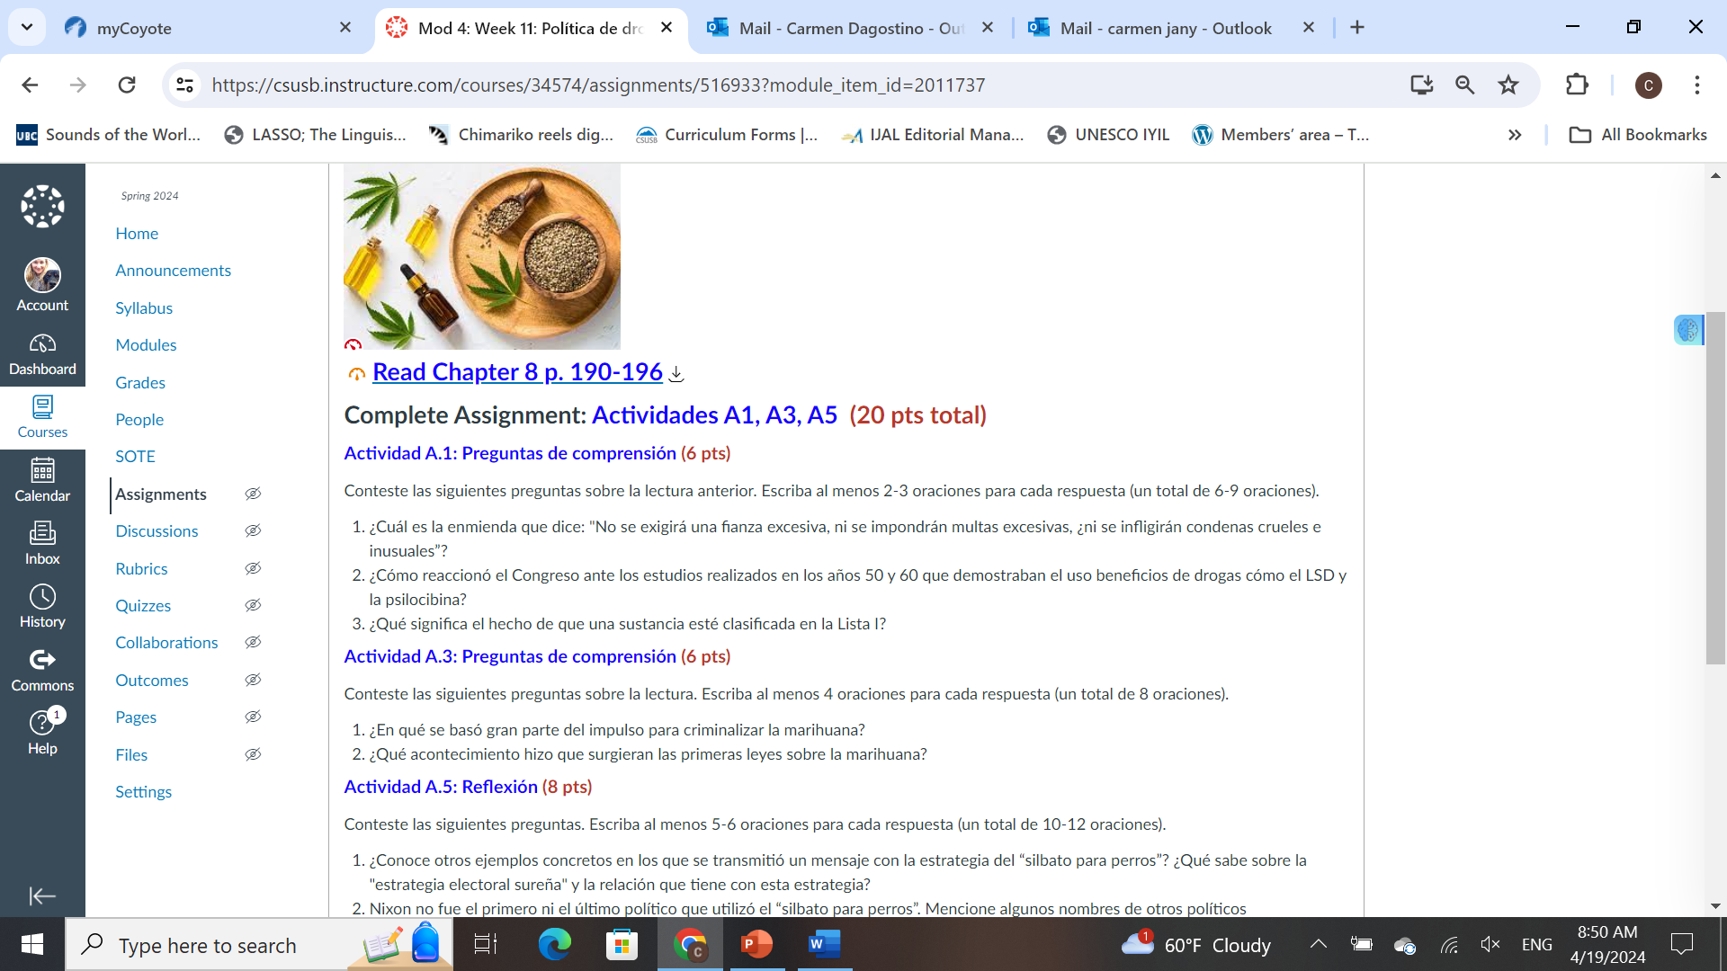
Illustrating Span 3061 in Canvas
Exercises are all individually programmed into Canvas

Slide 3
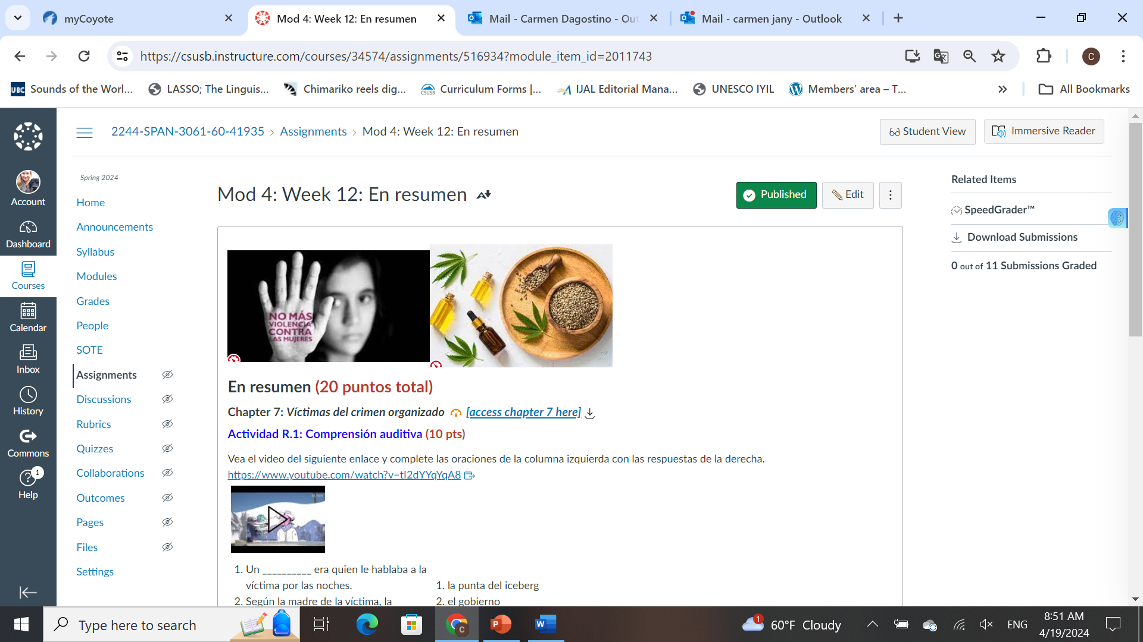
Illustrating Span 3061 in Canvas
Youtube videos & associated activities

Slide 4
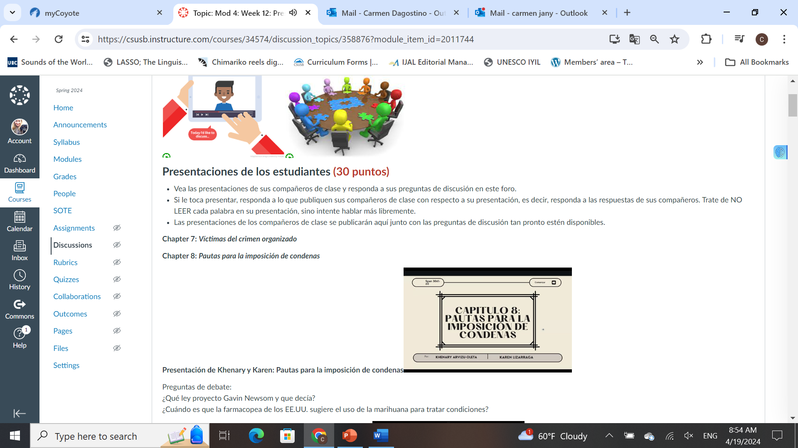
Illustrating Span 3061 in Canvas
Student research projects & video presentations (with discussion questions)

Slide 5
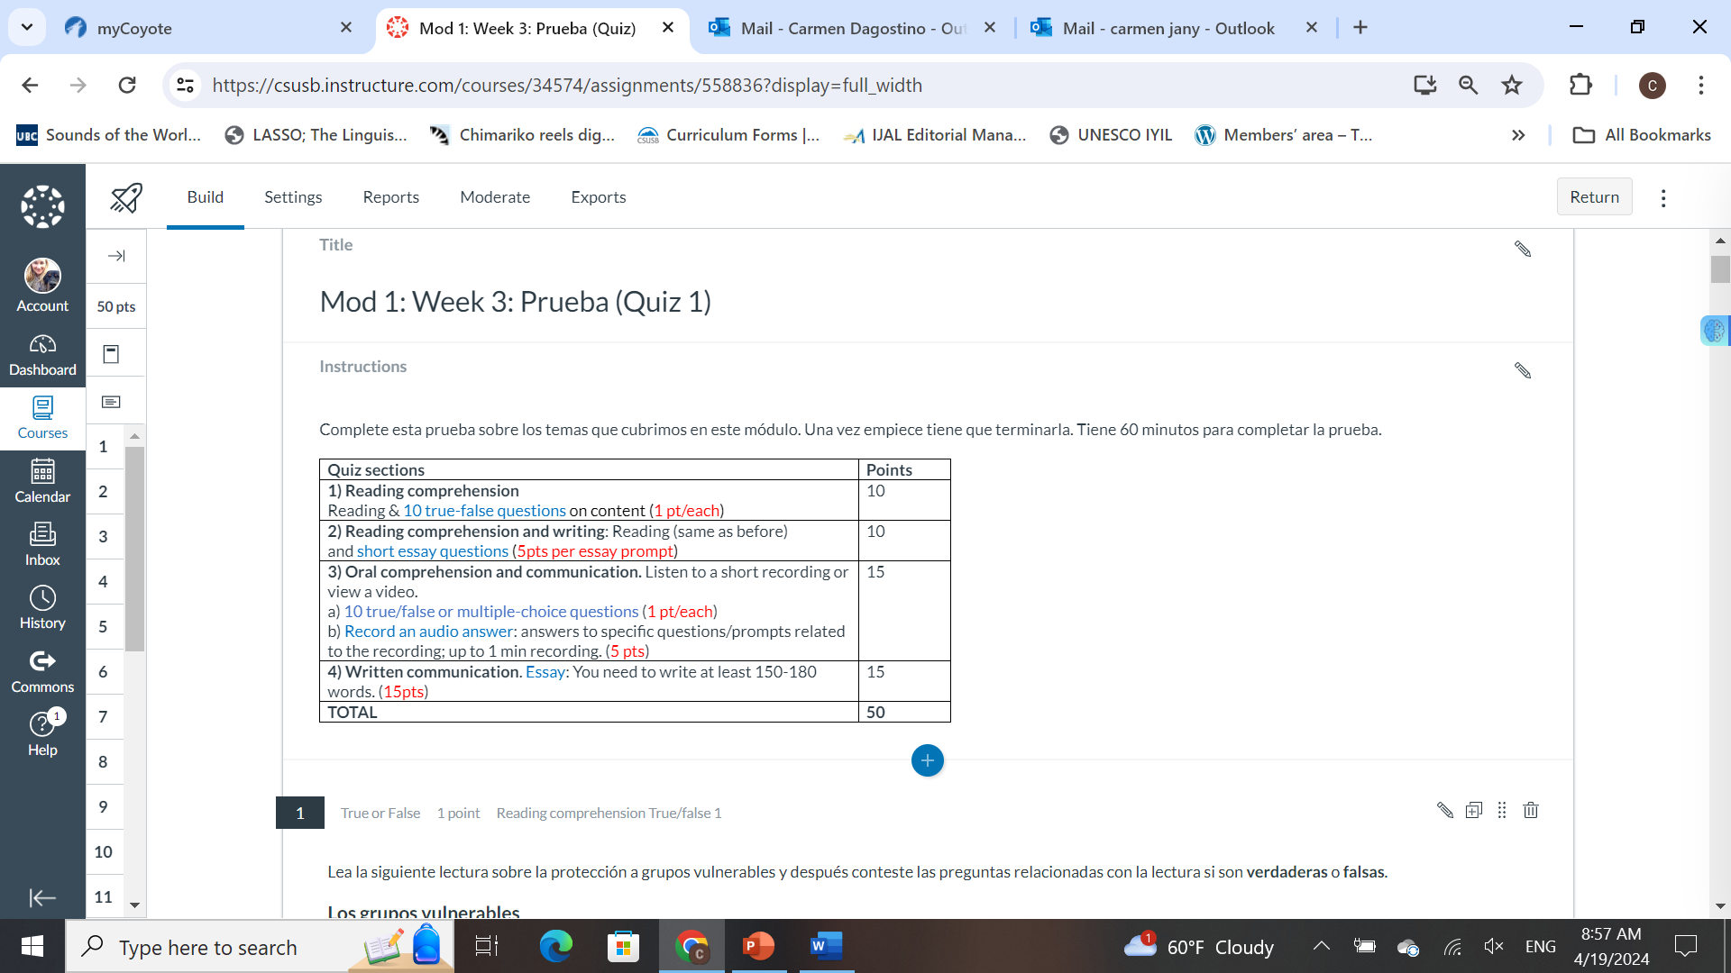
Illustrating Span 3061 in Canvas
Developed quizzes based on all materials

