Slide 1
Radiation Side Effects and Treatment
3105 – Patient Care Lab
Lauren Horton

Slide 2
Today we will cover:
Side effects of different cancers
Symptom treatments
Nutrition Plans

Slide 3
Types of Head and Neck Cancers
Oral Cavity Cancers
  Lip, floor of mouth, tongue
Pharynx Region Cancers
  Oropharynx
    Base of tongue, tonsils, soft palate
  Nasopharynx
    Posteriosuperior pharyngeal wall and lateral pharyngeal wall, eustachian tube orifice, adenoids
  Hypopharynx, aka laryngopharynx
    Pyriform sinuses, postcricoid, posterior pharyngeal walls

Slide 4
Head and Neck Cancers
Radiation Side effects:
  Dysphagia – difficulty swallowing
  Periodontal Disease and Caries – healing is poor after radiation treatment, so extractions after radiation are not recommended and can lead to osteoradionecrosis
  Malnutrition
  Mucositis/Stomatitis – mucous membranes are extremely radiosensitive. When they are irradiated, the membrane becomes inflamed and can slough off leaving a painful ulcerated surface
  Xerostomia – dry mouth that can lead to dental caries and oral infections
  Taste Changes
  Dry eye – lacrimal glands
  Skin Reactions – erythema, dryness, moist desquamation

Slide 5
Head and Neck Cancer Diet
Most patients that present with head and neck cancers have likely already lost some weight so maintaining a healthy weight is priority
Head and Neck Patients need to ensure they are staying hydrated and drinking plenty of water at each meal
Swallowing non pureed food can be challenging as treatment progresses, so liquid diet is recommended when swallowing becomes hard.
Ensure protein drinks or something similar is recommended to ensure the patients are get plenty of calories.
If a patient is not consuming food, they need to have approximately 2 ensure drinks per meal with a glass of water.
If a patient is no longer able to swallow, they will receive nutrition through their peg tube 3-4 times a day.

Slide 6
Diet Avoidance List
Spicy food
Coarse or raw veggies
Crackers and chips
Nuts
Sugary snacks
Mouthwash with alcohol
Cold/hot food and drinks

Slide 7
Head and Neck Cancer Symptom Management
Dysphagia – magic mouth wash, peg tube feedings
Xerostomia – saliva substitutes like Xerolube help decrease the mouth dryness
Skin reactions
  Moisturize locations and gels for dry desquamation
  Hydrocortisone cream can be applied to irritated, inflamed skin
    Do not apply to moist skin as it can cause an infection
  Domeboro for moist desquamation

Slide 8
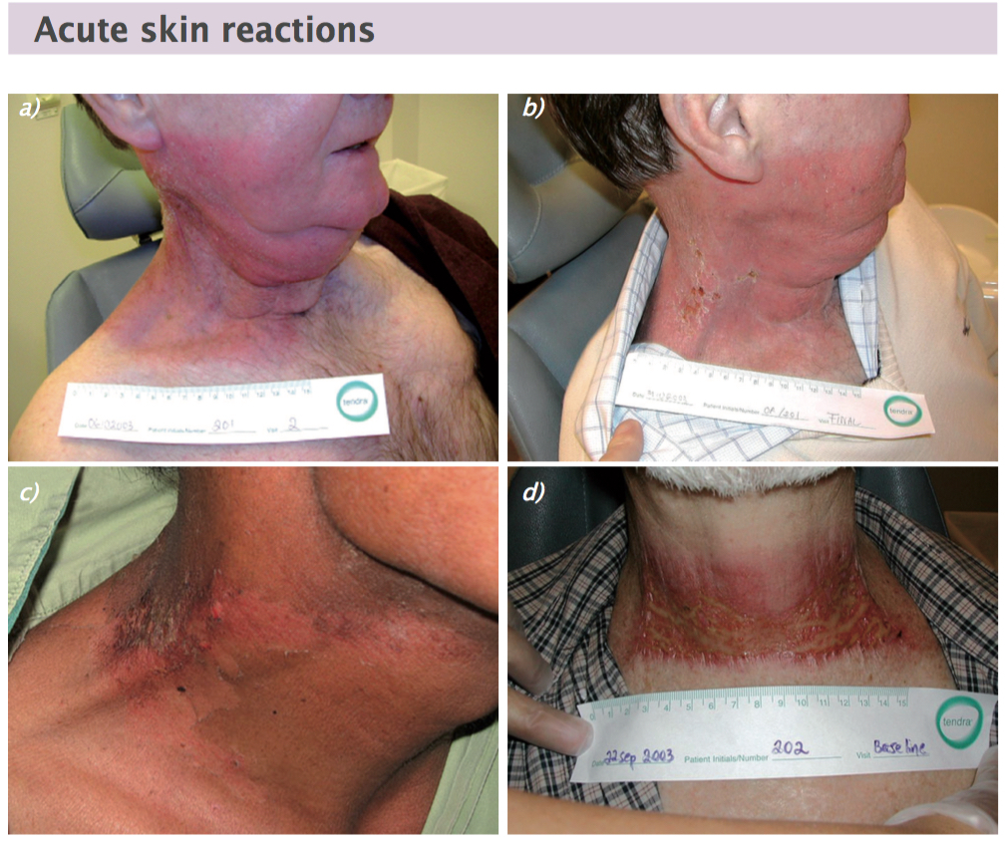

Slide 9

https://www.walmart.com/ip/Domeboro-Soothing-Soak-Rash-Relief-Astringent-one-box-of-12-packets-Each/443977654?wmlspartner=wlpa&selectedSellerId=348&adid=22222222227443977654_348_14069003552_202077872&wl0=&wl1=g&wl2=c&wl3=42423897272&wl4=pla-319455734609&wl5=9011160&wl6=&wl7=&wl8=&wl9=pla&wl10=111838607&wl11=online&wl12=443977654_348&veh=sem&gad_source=1&gad_campaignid=202077872&gbraid=0AAAAADmfBIr3c6kWZ7iXITRO3gPq2ZHVH&gclid=EAIaIQobChMIj-DY56_xjgMVfC7UAR1ngRAOEAQYASABEgKOYfD_BwE

Slide 10
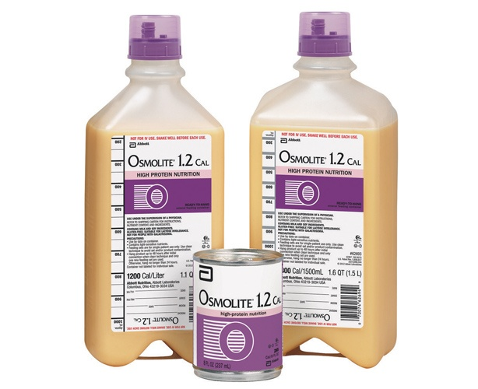
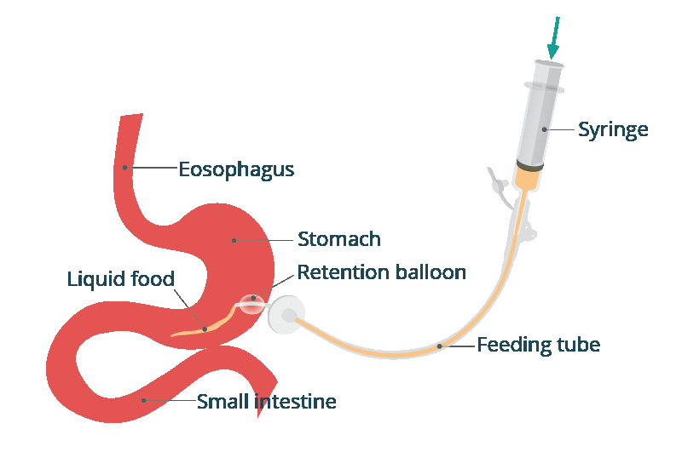
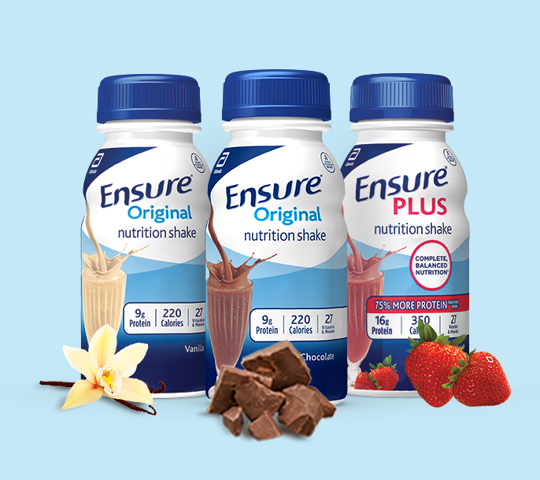
https://www.cwimedical.com/tube-feeding-without-fiber/osmolite-12-cal-tube-feeding-formula-osmolite?srsltid=AfmBOoqGEWz6P1ccM0wM2pLGVDqj1iqwduF27W0bUzsPfBRE7_aMNGAM
https://www.healthdirect.gov.au/peg-tube-placement
https://www.google.com/search?sca_esv=b0c8a5b5dae9aa98&rlz=1C1GCEA_enUS1052US1052&udm=2&fbs=AIIjpHxU7SXXniUZfeShr2fp4giZjSkgYzz5-5RrRWAIniWd7tzPwkE1KJWcRvaH01D-XIWOFp4UhuzIxwLSKiE1xF1ZWEqjZkRe51b9jK6AN71wXGlgfMAjhu_nxvE2OTRS_qJ8TIbYtQEGwTAxcUtLYkJKqs6wYgm-h8dEhSDi7piZRVgyJZhh8u7ig2JpG9aWk9w-wgD1_NBTB6UetozDfKxaC98Rbg&q=ensure&sa=X&ved=2ahUKEwiCwuqWr_GOAxWL5ckDHYUaKecQtKgLegQIExAB&biw=1920&bih=911&dpr=1#vhid=chd2vBP72aXP9M&vssid=mosaic

Slide 11
Types of Pelvic Cancers
Women
  Vulva, vagina, cervical, uterine, endometrial, ovarian, bladder, colon, rectal, anal
Men
  Prostate, penile, testicular, bladder, colon, rectal, anal

Slide 12
Pelvic Cancer Side Effects
Overall Side Effects of treating pelvic cancers in men and women
  Acute GI side effects
    Diarrhea
    Abdominal cramping
    Rectal discomfort
    Possible rectal bleeding
  Skin Erythema
    Anywhere that 2 skin surfaces rub together, there is a bigger skin reaction
  Fertility

Slide 13
Pelvic Cancer Diet and Avoiders
Aim for:
  High Protein diet
  Low Residue diet
  High water intake
  More carbohydrates
    White bread, noodles, etc
Avoid:
  Fatty foods
  Reduce consumption of red meat
  Avoid alcohol
  Limit sugary drinks
  Reduce consumption of raw vegetables and fruits
  Dairy

Slide 14
Pelvic Cancer Symptom Management
Diarrhea
  Diet change
  Antidiarrheal medication
Skin reactions
  Brisk erythema
    Topical steroid creams
  Moist desquamation
    Sitx baths, domeboro

Slide 15
Breast Cancer Treatment Side Effects
Radiation therapy side effects
  Acute skin changes
  Fatigue
  Lymphedema

Slide 16
Breast Cancer Diet
Most patients can carry on a typical diet
Patients should aim for:
  High water intake
  High protein
  Fruits and vegetables
Patients should avoid:
  Alcohol
  Fatty foods

Slide 17
Breast Cancer Symptom Management
Skin Changes
  Dry erythema
    Moisturize with Aquaphor or hydrocortisone cream to reduce itching
  Moist Desquamation
    Domeboro
Fatigue
  Rest throughout the day
Lymphedema
  Sleeves
  See a specialist

Slide 18
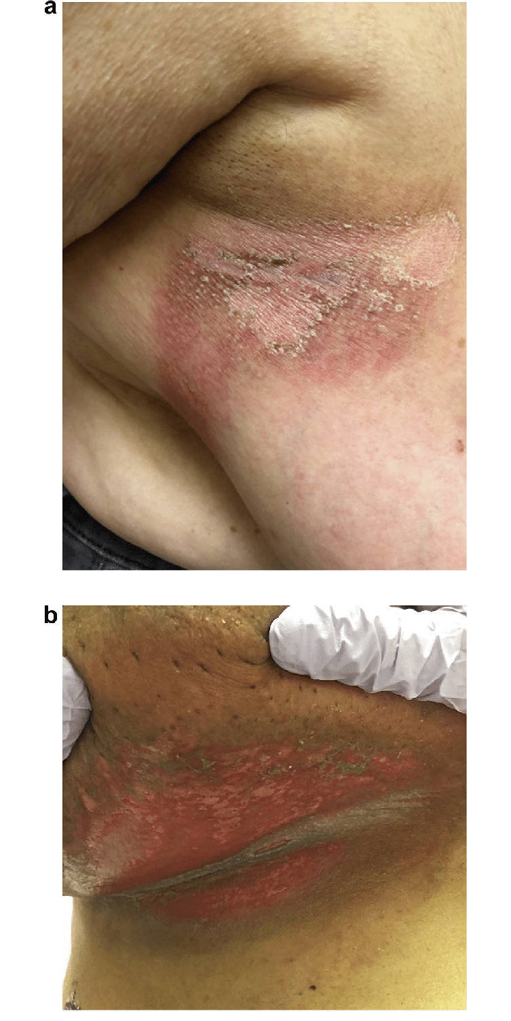
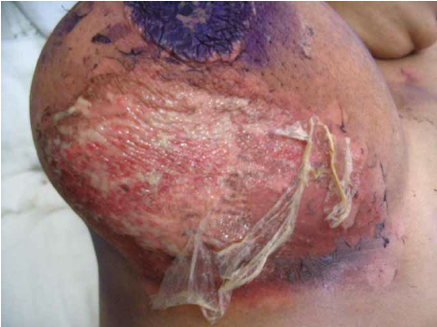

Slide 19
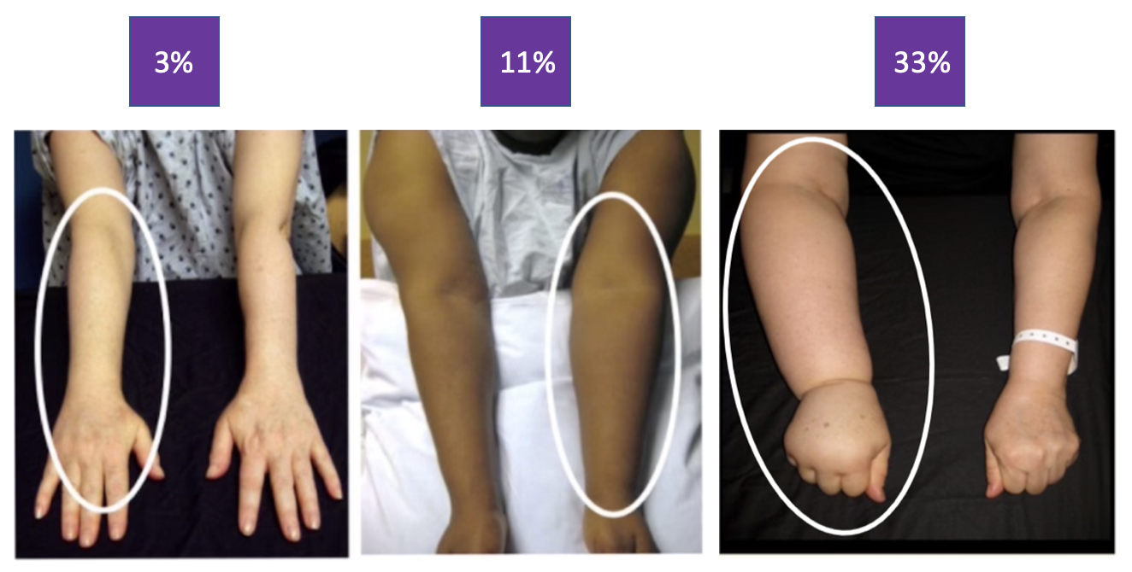
Lymphedema

Slide 20
Lung Cancer Treatment Side Effects
Anorexia
Weight loss
Skin changes
Esophagitis
  Swelling of esophagus
Dysphagia
  Difficulty swallowing
Odynophagia
  Painful swallowing

Slide 21
Lung Cancer Diet
Patients should aim for:
  Softer food diet
  High water intake
  High protein intake
  High protein liquid diet if unable to swallow food
Patient should avoid:
  Dry foods like crackers and chips
  Avoid hard to swallow foods

Slide 22
Lung Cancer Symptom Management
Skin changes
  Moisturize and domeboro if needed
Dysphagia and Odynophagia
  Magic Mouth was prescription
  Liquid diet change if unable to swallow

Slide 23
Sources
Washington, C., & Leaver, D. (2019). Principles and Practice of Radiation Therapy (5th Edition). Elsevier Health Sciences (US)

