Slide 1

REACH Pollution Presentation Introduction
Pollution Presentation Week 3 by Ariyani Challapalli, David Chen, Ekshika Patel, and Aimee Bernard is licensed under CC BY 4.0. ​

Slide 2
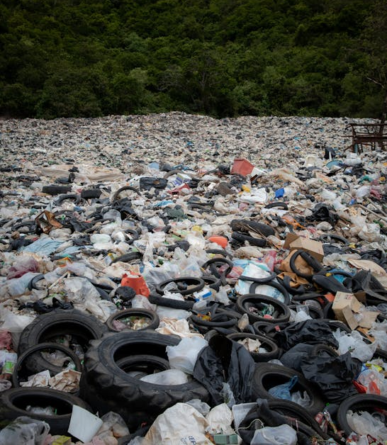
Air, Water, and Land Pollution
Air, Water, and Land Pollution
Notes:
Title: Landfill near Trees. Author: Leonid Danilov. Link: https://www.pexels.com/photo/landfill-near-trees-2768961/. Source: Pexels.

Slide 3
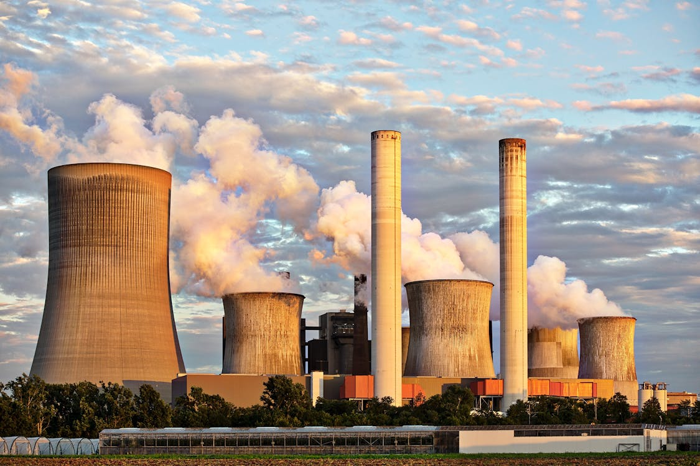
What is Pollution?
What is Pollution?
Pollution is anything that makes the Earth dirtier than we originally found it. It can be caused by trash, chemicals, or any other substance. Some types of pollution include:
  Air Pollution
  Water Pollution
  Land pollution
  Noise Pollution
  Light pollution
Notes:
Title: Landscape Photography of Factory. Author: Pixabay. Link: https://www.pexels.com/photo/landscape-photography-of-factory-459728/. Source: Pexels

Slide 4
What are sources of air pollution?
Factories
Driving vehicles like cars and trucks
Burning fossil fuels
Methane gas from livestock

Slide 5
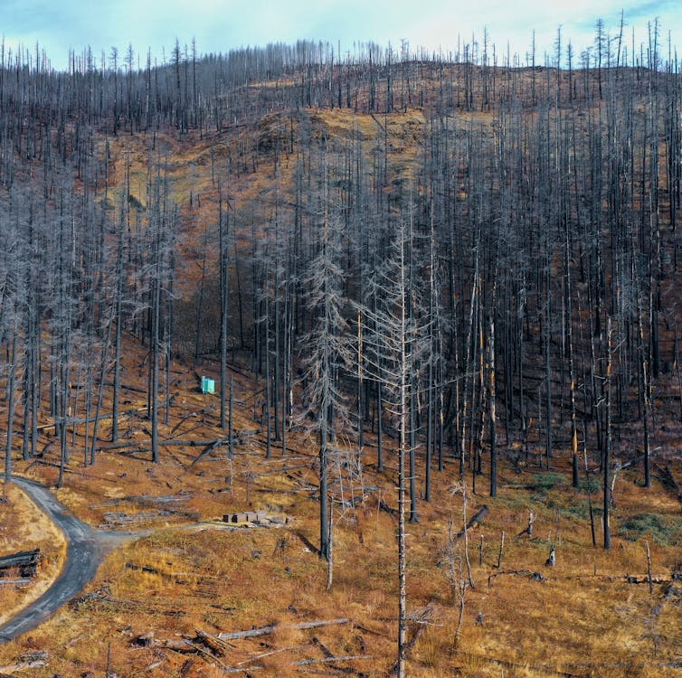
What is acid rain?
Acid rain is when pollutants from fossil fuels mix with water in the air and form acids
These acids can then fall to the earth in the form of rain and harm plants, animals, buildings, and marine life.
We will be doing an experiment on this today!
Notes:
Title: Leafless Mountain Forest. Author: Stephen McDaniel. Link: https://www.pexels.com/photo/leafless-mountain-forest-15396195/. Source: Pexels.

Slide 6


How does air pollution affect human health?
Lung problems
  Asthma
  Bronchitis
  Lung cancer
Heart problems
Allergies
Notes:
Credits:
Title: Medical Stethoscope with Red Paper Heart on White Surface. Author: Karolina Grabowska. Link: https://www.pexels.com/photo/medical-stethoscope-with-red-paper-heart-on-white-surface-4386467/. Source: Pexels.
Title: A Hand Wearing White Gloves Holding an Inhaler. Author: Luci. Link: https://www.pexels.com/photo/a-hand-wearing-white-gloves-holding-an-inhaler-6816451/. Source: Pexels.

Slide 7
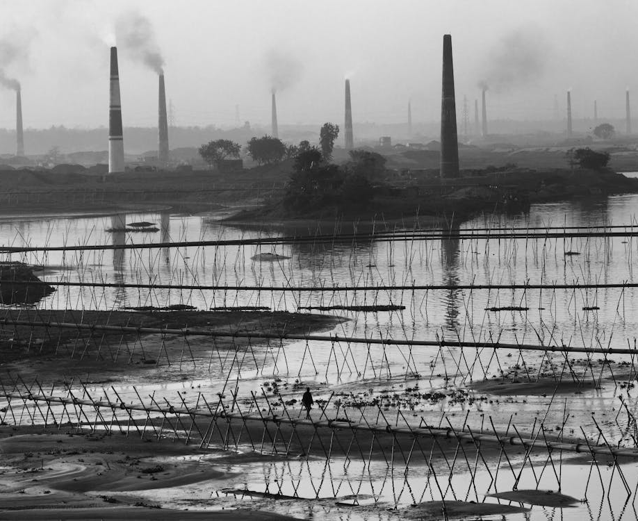
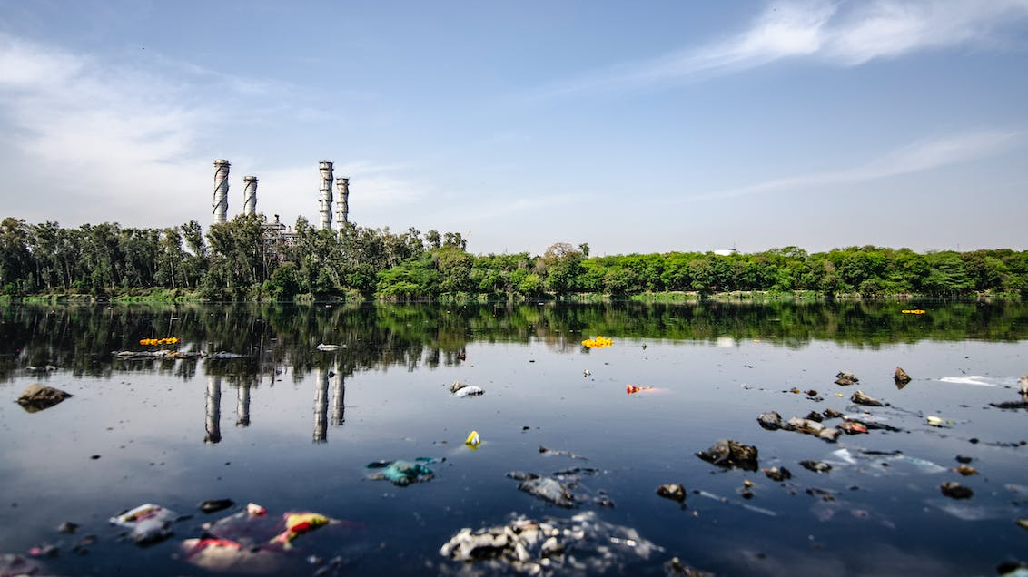
What are sources of water pollution?
Plastics
Chemicals from factories
Bacteria and other organisms
Kitchen and bathroom waste
Notes:
Credits:
Title: Gray Scale Photo of Metal Fence. Author: Ariful Haque. Link: https://www.pexels.com/photo/gray-scale-photo-of-metal-fence-3680457/. Source: Pexels.
Title: Garbage on Body of Water. Author: Yogendra Singh. Link: https://www.pexels.com/photo/garbage-on-body-of-water-2480807/. Source: Pexels.

Slide 8
How does water pollution affect human health?
Chemical poisoning of drinking water which can lead to illness
Bacterial contamination of drinking water which can also lead to illness
Decreased food supply because water pollution can harm marine life

Slide 9
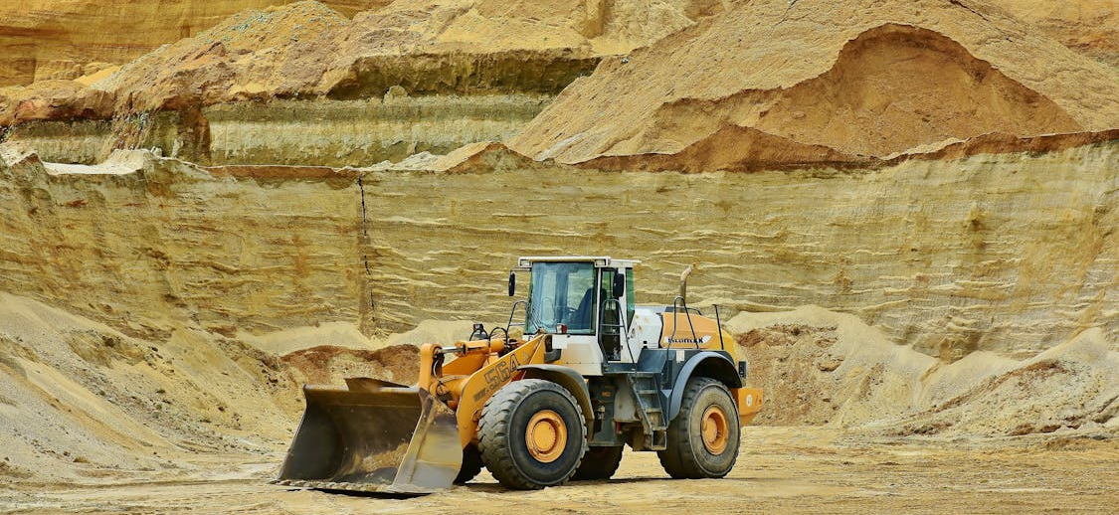
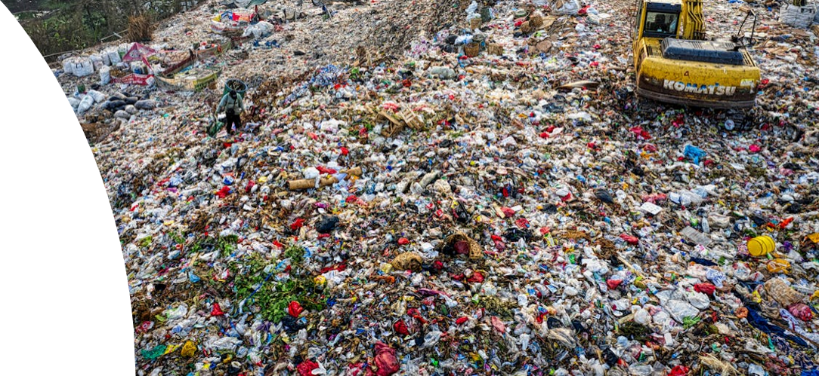
What are sources of land pollution?
Garbage
Medical waste
Mining activities
Sewage
Notes:
Credits:
Title: Front-end Loader. Author: Pixabay. Link: https://www.pexels.com/photo/front-end-loader-461789/. Source: Pexels.
Title: Drone Shot of Landfill. Author: Tom Fisk. Link: https://www.pexels.com/photo/drone-shot-of-landfill-3186574/. Source: Pexels.

Slide 10
How does land pollution affect human health?
Fewer green spaces to play in and spend time outdoors
Soil pollution can seep into the ground and affect how we grow food

Slide 11
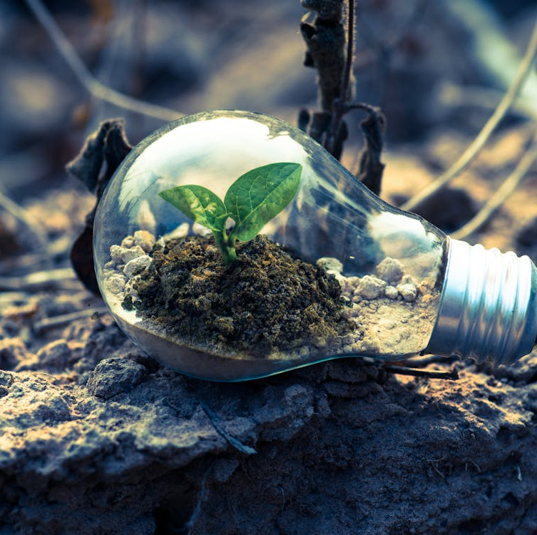
We can decrease pollution! How?
Change our energy sources (remember last week! ☺)
Plant more trees
Create less garbage – reduce, reuse, recycle
Use public transportation as much as possible
Write to our public officials
Notes:
Title: Clear Light Bulb Planter on Gray Rock. Author: Singkham. Link: https://www.pexels.com/photo/clear-light-bulb-planter-on-gray-rock-1108572/. Source: Pexels.

