Slide 1

REACH Energy Slideshow Introduction
Energy Presentation Week 2 by Ariyani Challapalli, David Chen, Ekshika Patel, and Aimee Bernard is licensed under CC BY 4.0.

Slide 2
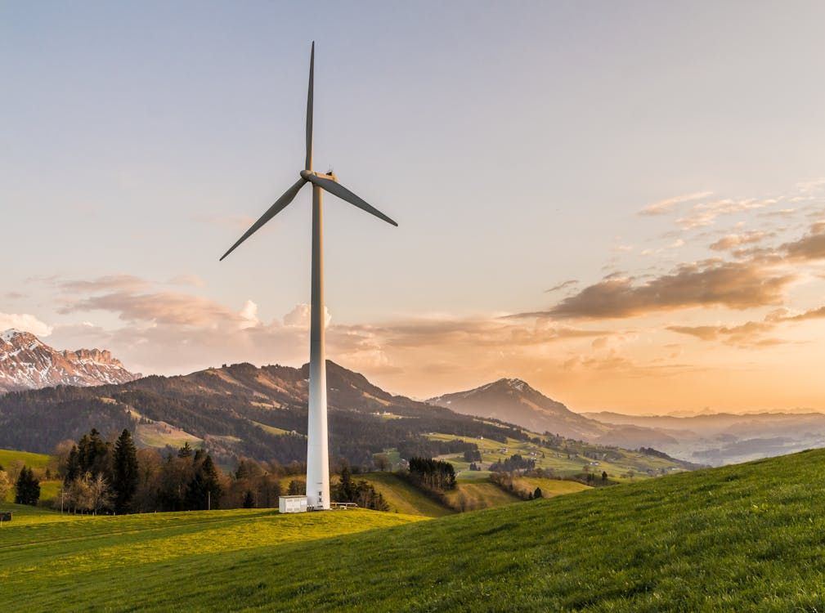
What is Energy?
Renewable and Non-renewable
Notes:
Title: White Windmill. Author: Pixabay. Link: https://www.pexels.com/photo/white-windmill-414837/. Source: Pexels.

Slide 3
What do we use energy for?
To power transportation (cars, trains, buses, light rails, etc.)
To turn on the lights
To cook – stove, oven, microwave
To get access to water
For electricity for this Powerpoint!

Slide 4
What are some sources of energy? Shout it out!
Coal
Solar
Wind
Oil
Natural gas
Hydropower
And so much more!

Slide 5
What is the difference between non-renewable and renewable energy?
Non-renewable energy sources will run out because we do not have an endless supply!
In other words, we can use them up.
Renewable energy sources will not run out
In other words, we can keep using them over and over.

Slide 6









Renewable and Non-Renewable Sources
Renewable
Non-renewable
Solar
Wind
Nuclear
Coal
Biomass
Natural gas
Hydropower
Geothermal
Oil

Slide 7
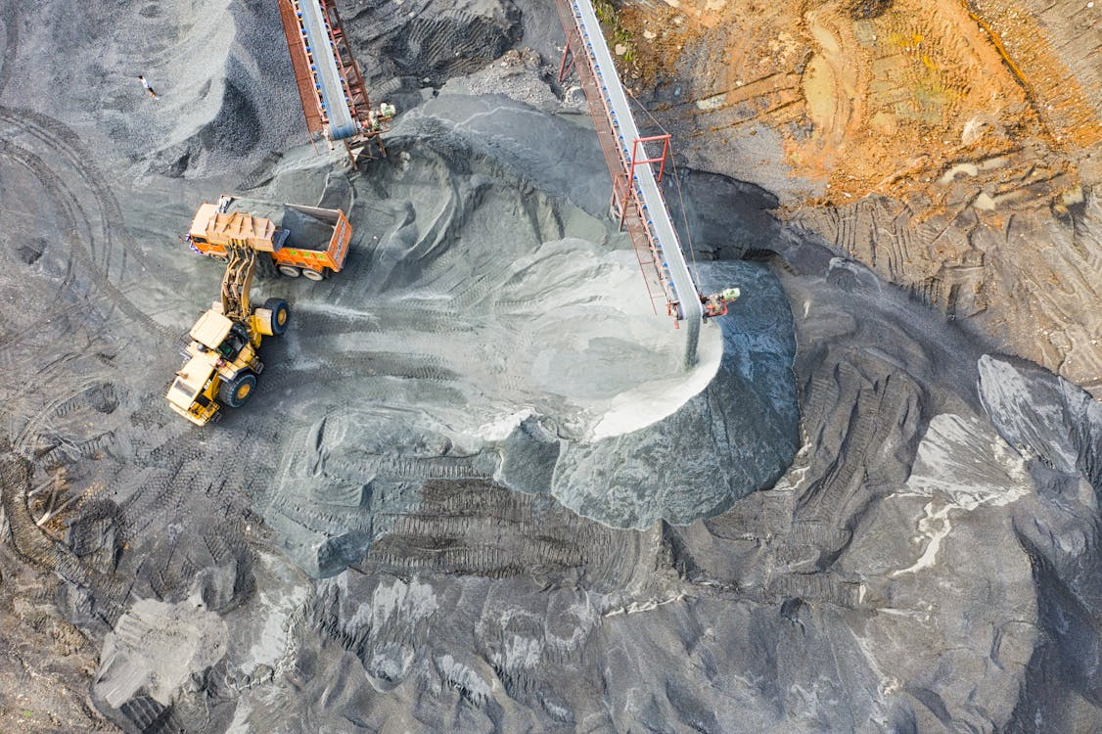
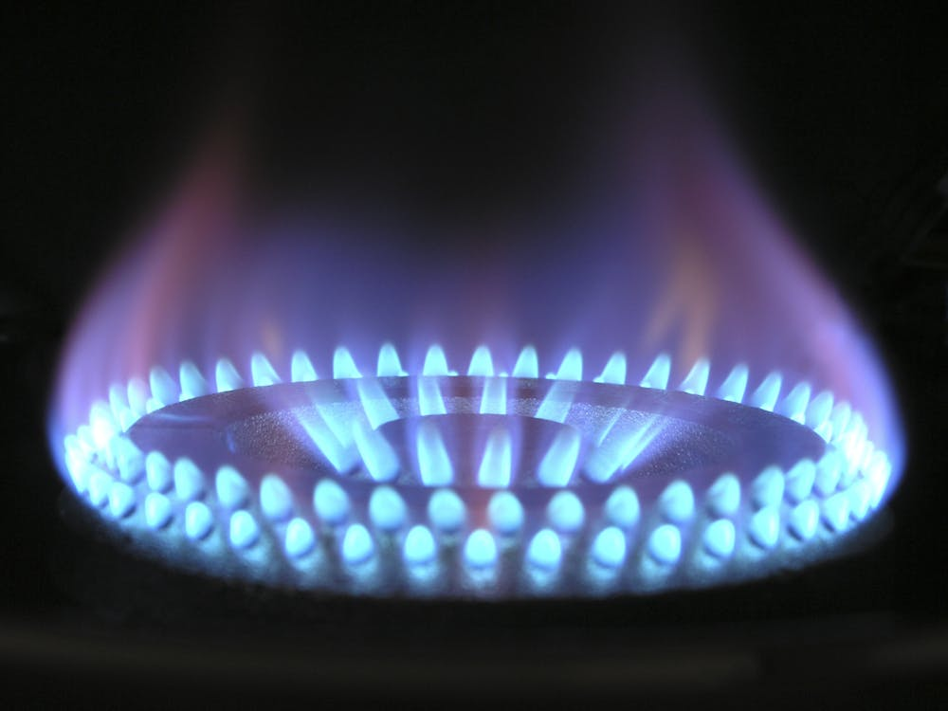
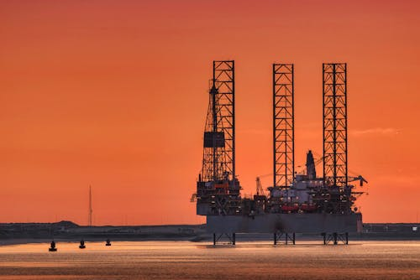
Where do our main sources of energy come from?
Fossil fuels – what are they?
Fossil fuels are a type of energy that come from dead plants and animals millions of years ago.
  These remains get covered over time with pressure and heat, creating different types of energy sources
There are 3 main types of fossil fuels
Coal
  Oil
  Natural gas
Fossil fuels are non-renewable
Notes:
Credits
Title: Yellow Excavator. Author: Tom Fisk. Link: https://www.pexels.com/photo/yellow-excavator-2101137/. Source: Pexels
Title: Oil Rig at Sunset. Author: A P. Link: https://www.pexels.com/search/oil%20industry/. Source: Pexels
Title: Burning Stove. Author: Pixabay. Link: https://www.pexels.com/photo/burning-stove-266896/. Source: Pexels

Slide 8


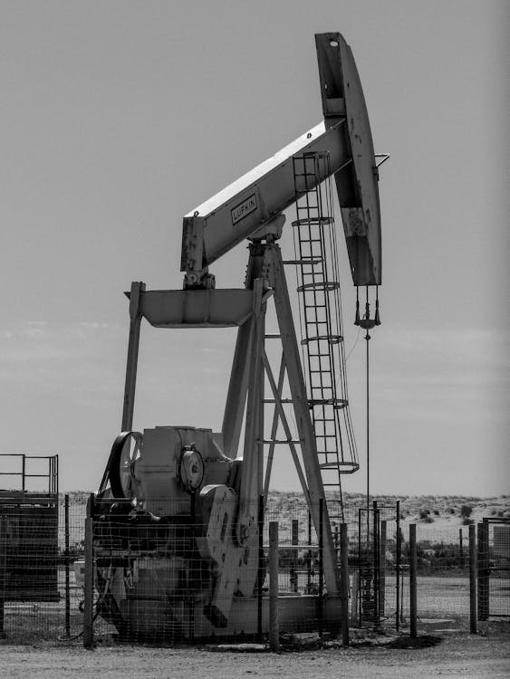
Fossil Fuels Explained!
Millions of years ago, many plants and animals died.
Over time, they were covered in water and dirt underground.
Carbon and hydrogen is stored in these plants and animals. When humans extract coal or drill for oil, they burn those elements for energy.
Notes:
Credits:
Title: Brown Grass on Body of Water. Author: Inga Seliverstova. Link: https://www.pexels.com/photo/brown-grass-on-body-of-water-3703595/. Source: Pexels.
Title: Trees Reflection on Puddle of Water. Author: Dids. Link: https://www.pexels.com/photo/trees-reflection-on-puddle-of-water-2790983/. Source: Pexels.
Title: À la plage. Author: Quentin Chansaulme. Link: https://www.pexels.com/photo/a-la-plage-16822265/. Source: Pexels.

Slide 9
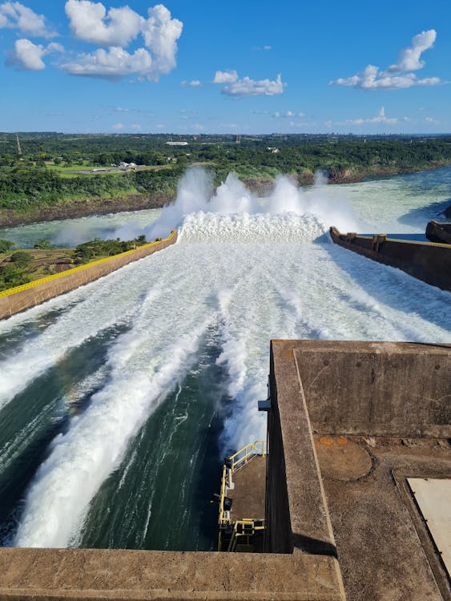
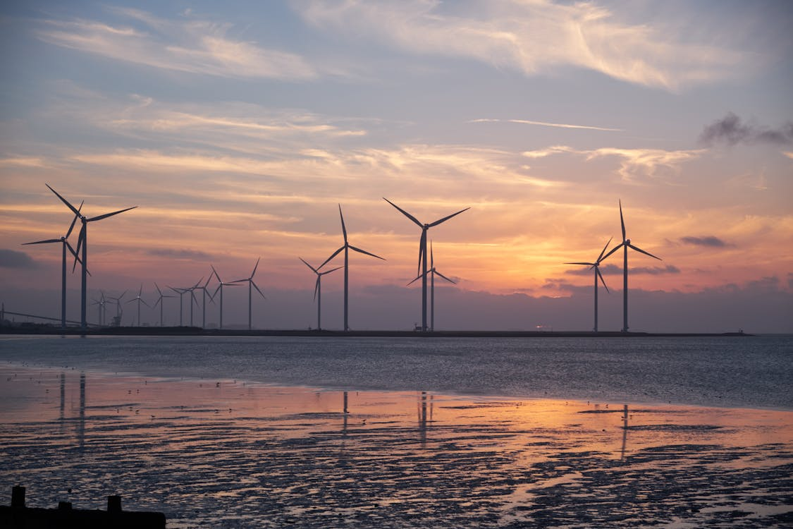
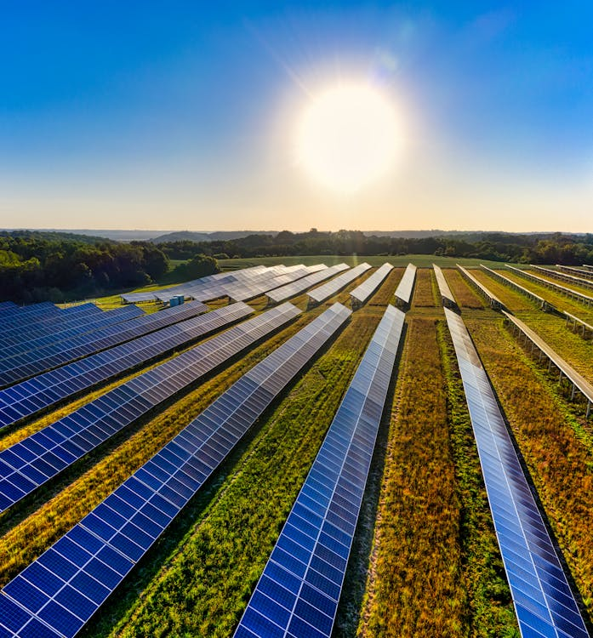
What makes an energy source renewable?
It comes from a source that will last for many, many years!
What are these energy sources?
  Wind
  Solar
  Water
Notes:
Credits:
Title: Wind Turbine Landscape Photography. Author: Pixabay. Link: https://www.pexels.com/photo/wind-turbine-landscape-photography-532192/. Source: Pexels.
Title: Solar Farm at Sunny Day. Author: Tom Fisk. Link: https://www.pexels.com/photo/solar-farm-at-sunny-day-9893729/. Source: Pexels.
Title: Splashing Water at Dam. Author: Flávia Sandriany. Link: https://www.pexels.com/photo/splashing-water-at-dam-17387403/. Source: Pexels.

Slide 10
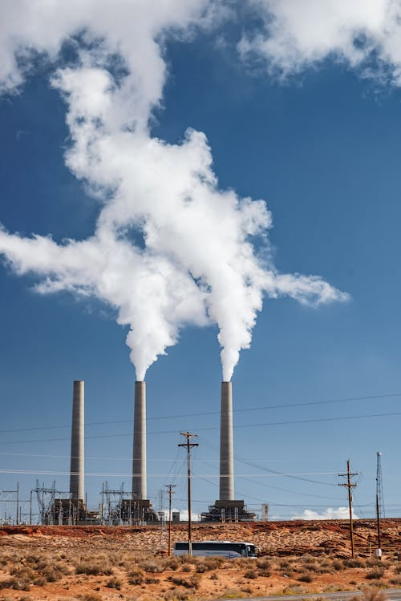
What are advantages and disadvantages of fossil fuels?
Advantages:
Fossil fuels have historically been cheap.
Disadvantages:
We are using them faster than they are being made!
They can cause pollution and harm human health.
They cause climate change and rising temperatures.
They power the activities we do.
Notes:
Title: Gray Concrete Factory Chimney Releasing Smokes. Author: Vlad Chețan. Link: https://www.pexels.com/photo/gray-concrete-factory-chimney-releasing-smokes-3387159/. Source: Pexels.

Slide 11
What are some health impacts of fossil fuels?
Asthma – making it hard for us to breathe
Heart health
Increased heat can make people sicker
Increased spread of disease

Slide 12
What can we do to reduce these impacts?
Invest in renewable energy!
What are these types of energy? Shout them out!

Slide 13
Activity time!
Oil spill creation and clean-up!
Matching card game!

