Slide 1

REACH Biodiversity Slideshow Introduction
Biodiversity Presentation Week 1 by Ariyani Challapalli, David Chen, Ekshika Patel, and Aimee Bernard is licensed under CC BY 4.0.

Slide 2
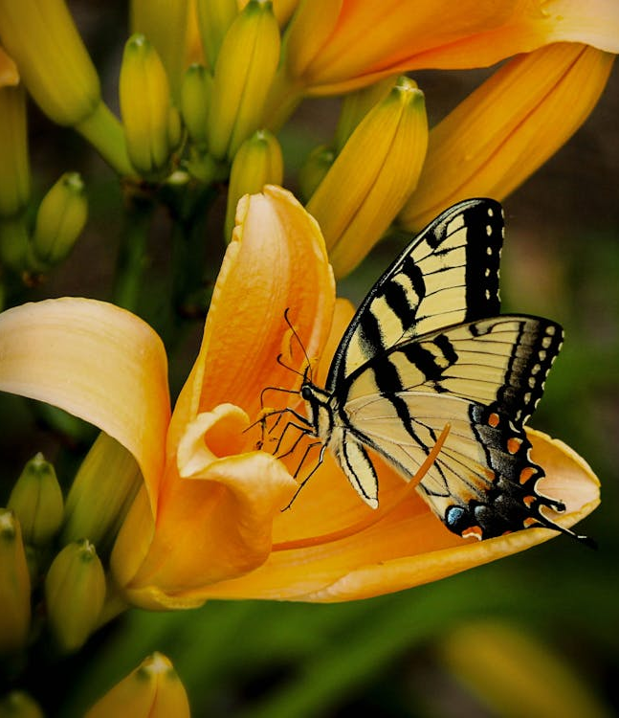
Biodiversity!
Notes:
Credit: "Black and White Butterfly Perch on Yellow Petaled Flower." Author: Pixabay. Link: https://www.pexels.com/photo/black-and-white-butterfly-perch-on-yellow-petaled-flower-67811/. Source: Pexels.

Slide 3
What are some words related to biodiversity?
Ecosystem
Biome
Conservation
Endangered species

Slide 4
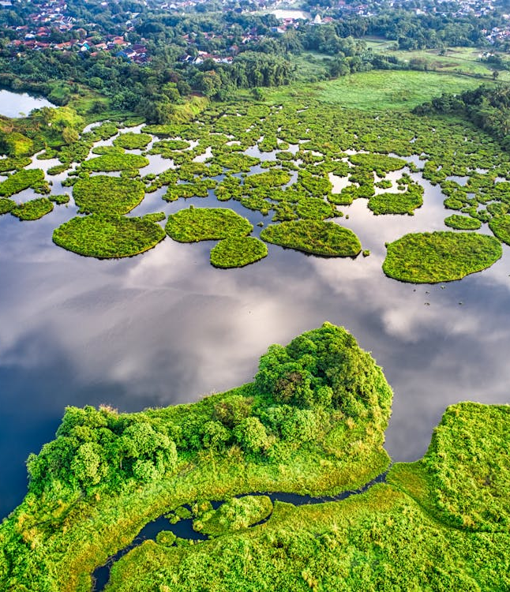
What are some examples of biomes?
Rainforest
Desert
Arctic
Ocean
Grassland
Wetland
Notes:
Credit
Title: "Landscape Photography of Green Islands." Author: Tom Fisk. Link: https://www.pexels.com/photo/landscape-photography-of-green-islands-2283496/. Source: Pexels.

Slide 5
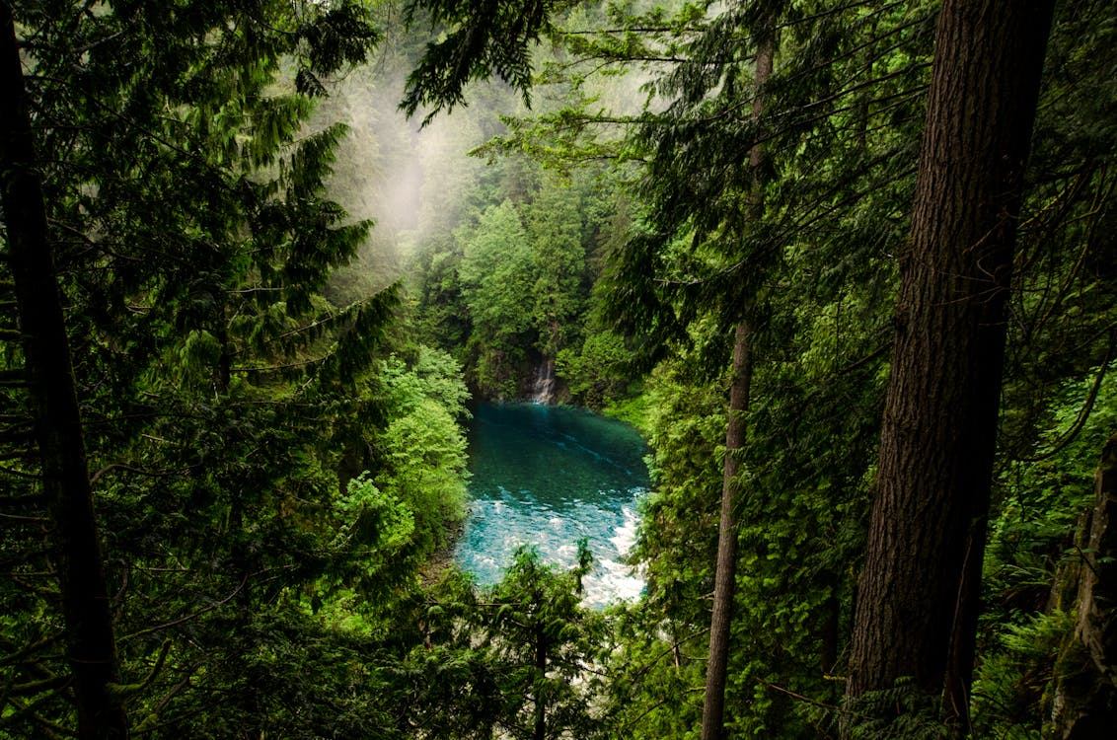
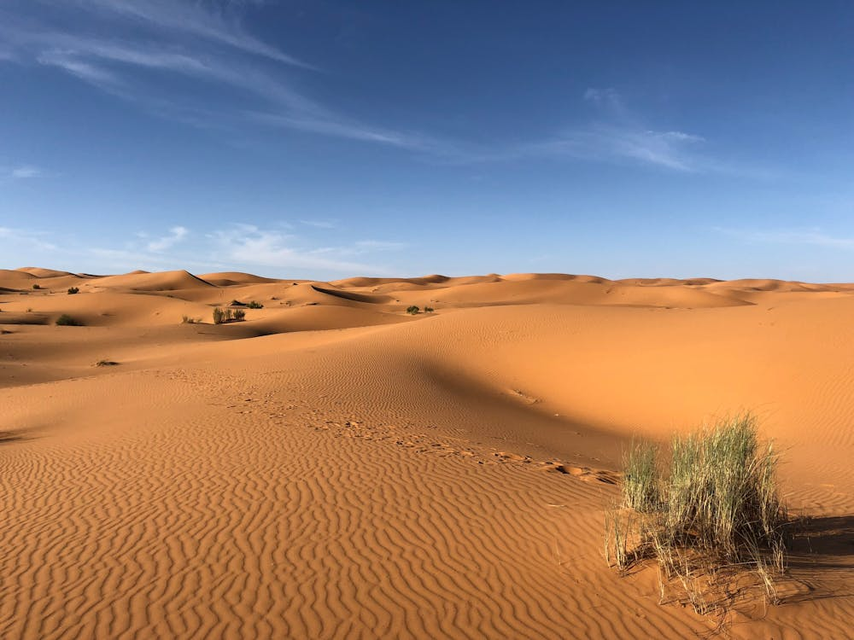
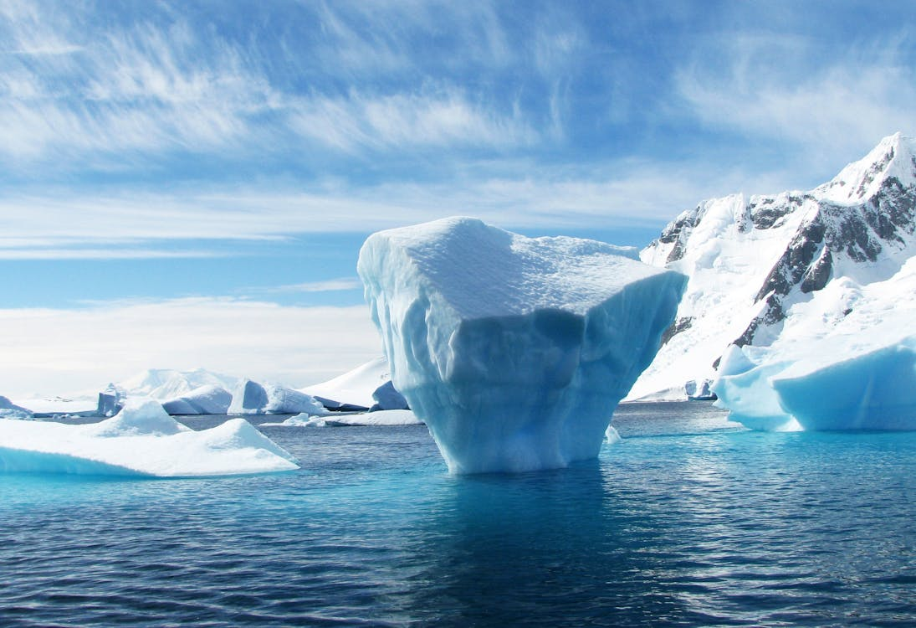
What are some connections between these biomes and health?
Lungs of the Earth
Help purify our air and water
Create important deposits of minerals that we use for life on Earth
Store carbon dioxide
Sea ice reflects back sunlight, helping to maintain global temperatures so that humans can live and grow food
Notes:
Credits:
Title: Body of Water in Forest. Author: Jonathan Meyer. Link: https://www.pexels.com/photo/body-of-water-in-forest-632280/. Source: Pexels.
Title: Green Grasses on Sahara Desert. Author: Greg Gulik. Link: https://www.pexels.com/photo/green-grasses-on-sahara-desert-1001435/. Source: Pexels.
Title: Iceberg During Daytime. Author: Pixabay. Link: https://www.pexels.com/photo/iceberg-during-daytime-53389/. Source: Pexels.

Slide 6
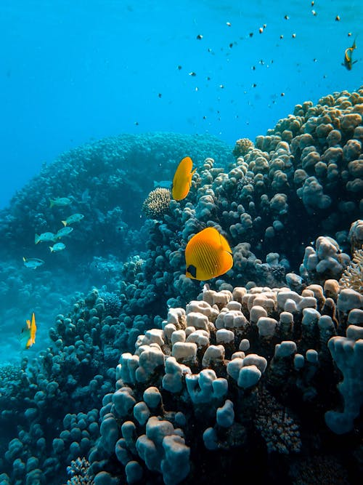
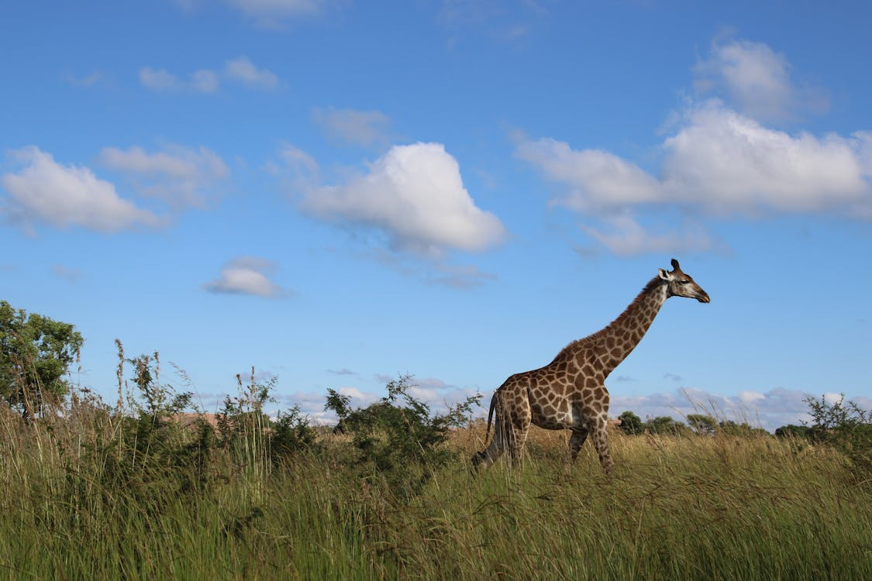
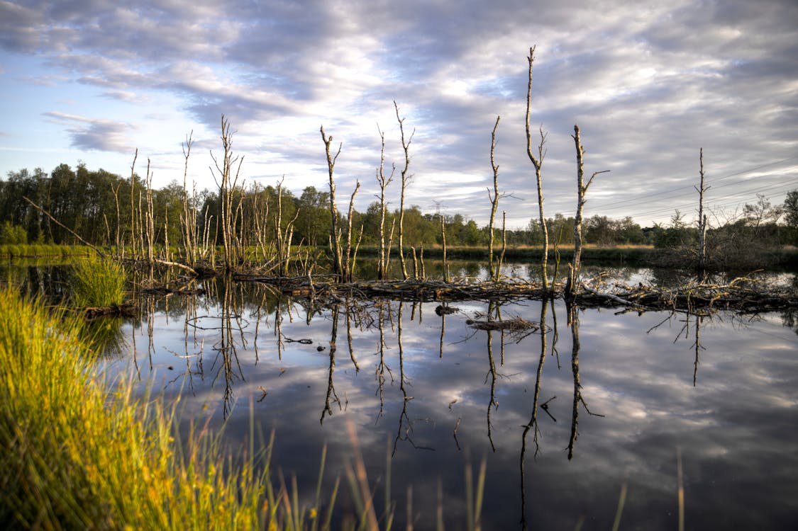
What are some connections between biodiversity and health?
Part of the freshwater environment, which humans need for drinking water
Support diverse life forms
Fishing can provide a source of food for humans
Oceans provide half the oxygen we breathe
Used for farming for thousands of years
Store carbon dioxide
Notes:
Credits:
Title: Body of Water Near Green Trees Under Cloudy Sky. Author: Skitterphoto. Link: https://www.pexels.com/photo/clouds-countryside-dawn-dusk-445190/. Source: Pexels.
Title: Sea Animals near Coral Reefs. Author: Francesco Ungaro. Link: https://www.pexels.com/photo/sea-animals-near-coral-reefs-3390587/. Source: Pexels.
Title: Giraffe Standing on Green Grass. Author: Magda Ehlers. Link: https://www.pexels.com/photo/giraffe-standing-on-green-grass-368060/. Source: Pexels

Slide 7
Activity time!
Match animals to their biomes!
Make a mini biome!

