Slide 1


REACH Make your Own Solar Oven
Make Your Own Solar Oven!
REACH at Home Solar Oven Experiment by Ariyani Challapalli, David Chen, Ekshika Patel, and Aimee Bernard is licensed under CC BY 4.0.

Slide 2
The Science Behind the Activity
We use energy for everything we do, from turning on the lights to making cookies! Certain forms of energy like coal and natural gas release a lot of pollutants into the air. Have you ever thought about how we can power our activities without pollution? What if we used the sun’s rays?
In this activity, we will create a solar powered oven and use it to make S’mores. We will take a pizza box and cut out a “panel.” We will then cover the panel in aluminum foil. Our chocolate and marshmallows will sit on the base of the pizza box.
Since aluminum foil is really shiny, it will reflect the sun’s rays onto the chocolate and marshmallows. Our solar oven will convert electromagnetic radiation from the sun into thermal energy that will cook our yummy S’mores! The best part is that solar is a renewable energy source, so we can keep using it over and over!

Slide 3
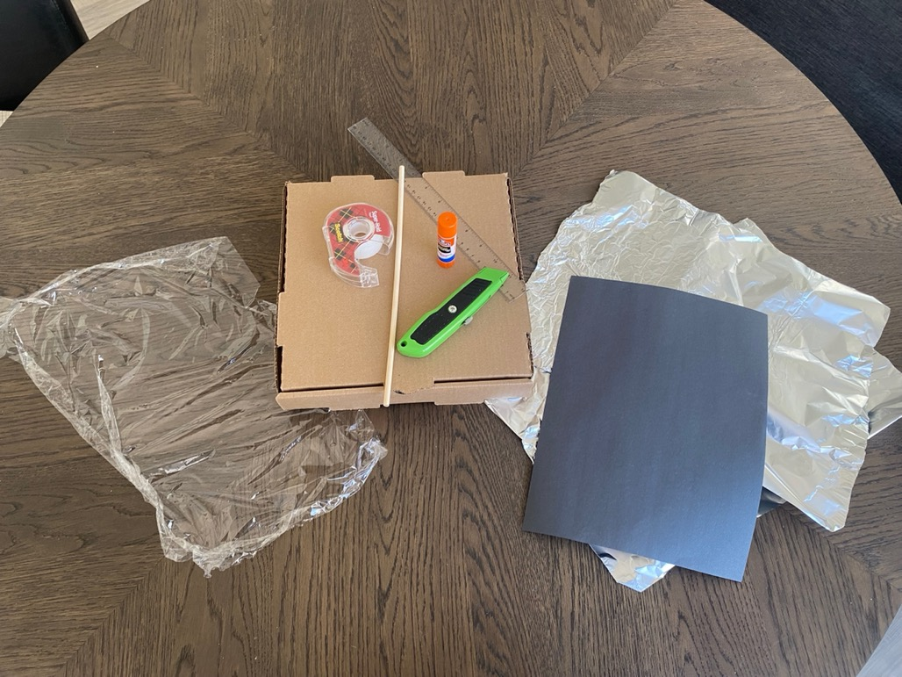
Materials
Pizza box
Aluminum foil
Plastic wrap
Black construction paper
Wooden stick
Box cutter
Glue stick
Ruler
Graham crackers, marshmallows, and chocolate

Slide 4
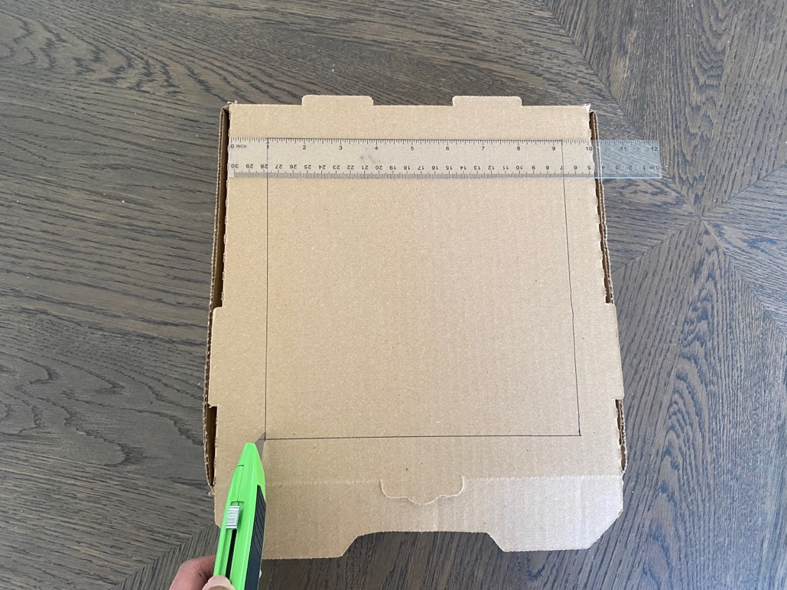
Step 1
Measure out 1 inch on each side of the box and cut out a lid flap.
(Remember to have an adult use the box cutter!)

Slide 5
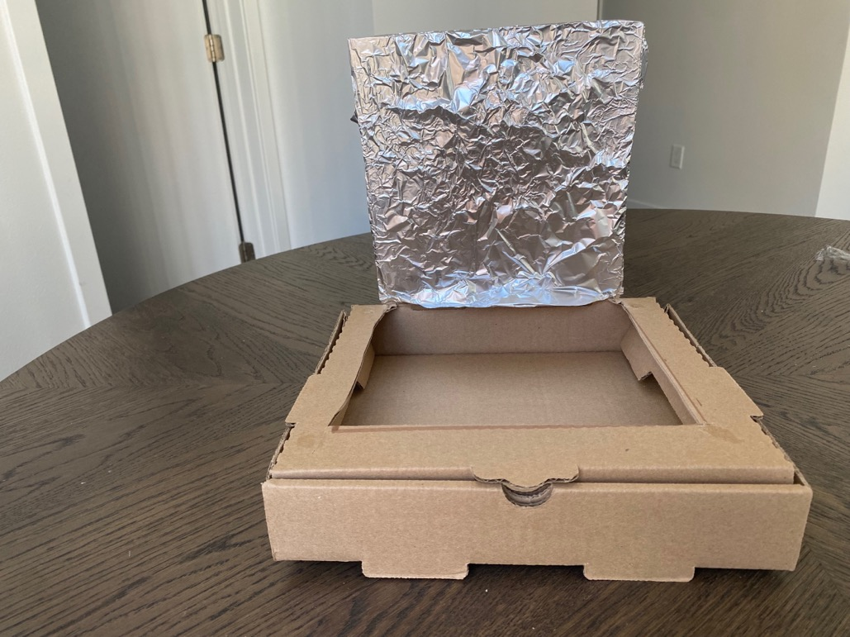
Step 2
Wrap the lid with aluminum foil.

Slide 6
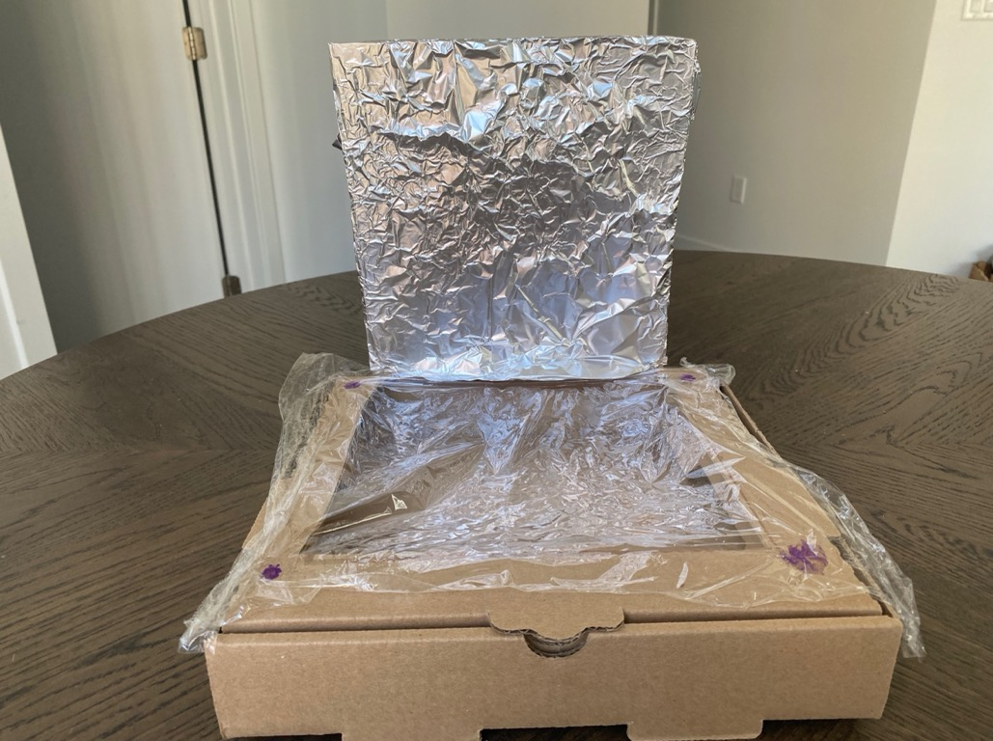
Step 3
Wrap the opening to the new pizza box with plastic wrap.

Slide 7
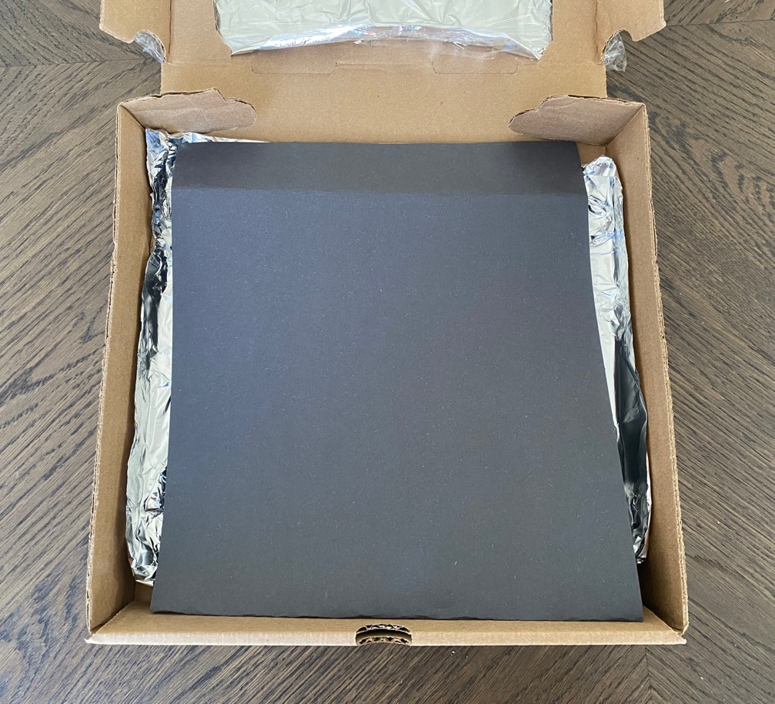
Step 4
Place aluminum foil on the bottom of the box. Place a piece of black paper over that.
Then, place your marshmallow and chocolate in the box.

Slide 8
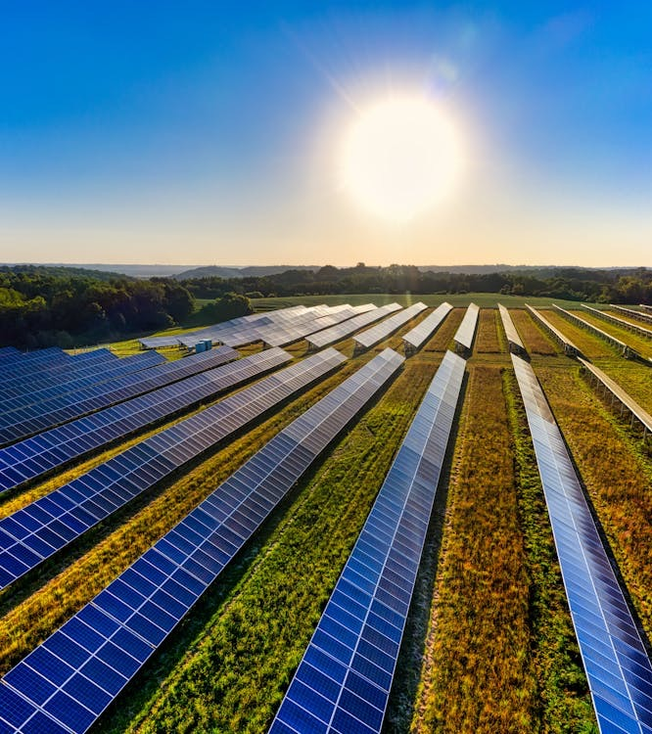
Quick Note: Why did we use black paper?
Black is a dark color, which means it absorbs sunlight really well. We want the chocolate and marshmallows to absorb energy so they heat up.
Remember we used aluminum foil because that is shiny and reflects light into the box.

Slide 9
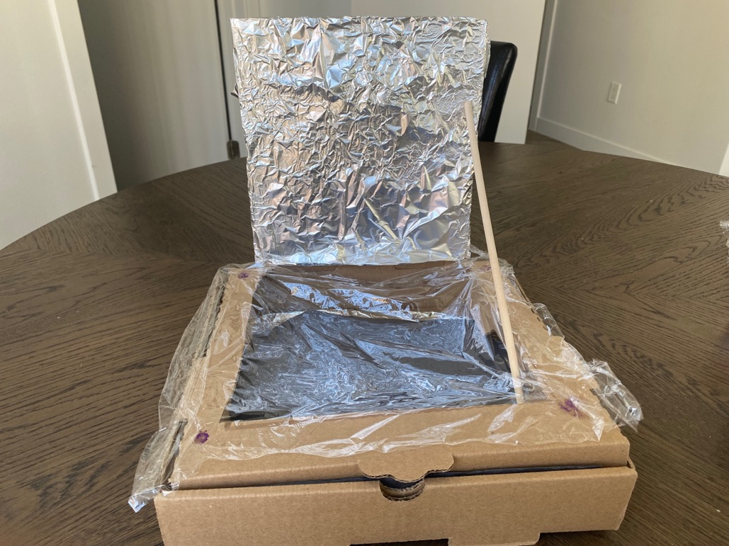
Step 5
Close the lid. Hold up the “panel” by taping a wooden stick.

Slide 10
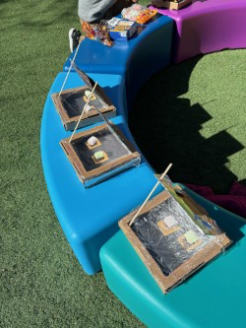
Step 6
Cook your s’mores outside for 25 minutes and enjoy!

Slide 11
Health Connection
How can solar energy improve human health?

Slide 12
Reflection
If you could repeat this activity, how would you help your s’mores cook faster? What would happen if you used more aluminum foil?
What would happen if it was not a sunny day? How would we cook our s’mores even on a rainy day? Be creative!
Remind yourself – what is the difference between non-renewable and renewable energy?

