Slide 1

REACh Jeopardy slideshow
REACH Final Jeopardy by Ariyani Challapalli, David Chen, Ekshika Patel, and Aimee Bernard is licensed under CC BY 4.0.
Credit and attribution to Slides Carnival for the Jeopardy Template.

Slide 2
R.E.A.C.H. EDITION

Slide 3
GAME RULES
Get into groups of 2-3 and select a topic and associated money amount!
Please provide your answers in the form of a question: “What is/are […]?”
If you get the answer correct, you keep choosing questions! Otherwise it moves to the next group.
Whichever group has the most ‘money’ at the end, wins!

Slide 4
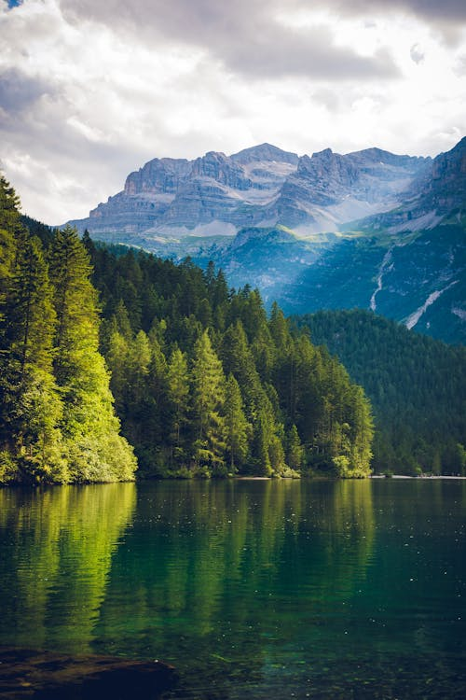
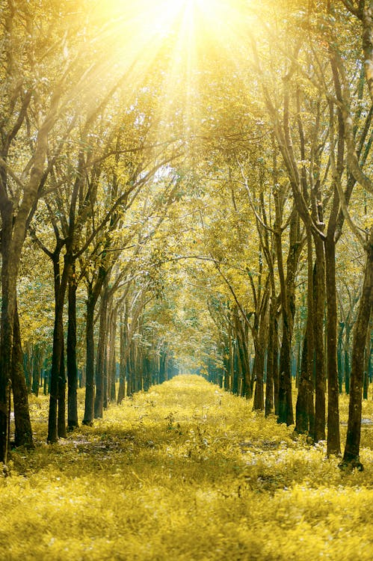
Panel
Biodiversity
Energy
Pollution
$200
$200
$200
$400
$400
$400
$600
$600
$600
$800
$800
$800
$1000
$1000
$1000
Notes:
Credits:
Title: Scenic View of Mountain. Author: Philip Ackermann. Link: https://www.pexels.com/photo/scenic-view-of-mountain-1666021/. Source: Pexels.
Title: Scenic View of the Forest During Sunrise. Author: Min An. Link: https://www.pexels.com/photo/scenic-view-of-the-forest-during-sunrise-1006121/. Source: Pexels.

Slide 5
This biome contains cacti, lizards, and sand
Biodiversity· $200
Notes:
What is the desert?

Slide 6
Another term for animals at risk for losing their home
Biodiversity· $400
Notes:
What are endangered species?

Slide 7
This biome provides half of the oxygen we breathe as humans
Biodiversity· $600
Notes:
What is the ocean?

Slide 8
This biome reflects sunlight to maintain global temperature
Biodiversity· $800
Notes:
What is the arctic?

Slide 9
This is known as the ‘lungs of the Earth’
Biodiversity· $1000
Notes:
What are trees?

Slide 10
This form of energy runs out and is non- [….]
Energy· $200
Notes:
What is renewable?

Slide 11
This type of non-renewable energy was formed millions of years ago.
Energy· $400
Notes:
What are fossil fuels?

Slide 12
This form of renewable energy comes from the sun.
Energy· $600
Notes:
What is solar power?

Slide 13
Windmills help generate this type of renewable energy.
energy· $800
Notes:
What is wind power?

Slide 14
These are the components of fossil fuels.
energy· $1000
Notes:
What are plants?
What are dead animals?

Slide 15
Name one way we can reduce pollution.
pollution· $200
Notes:
What is reduce, reuse, recycle?
What is changing energy sources?
What is using public transportation?
This is variable, as long as the group gives a reasonable answer they can get the points

Slide 16
This type of pollution makes it difficult to see the stars in the sky.
pollution· $400
Notes:
What is light pollution?

Slide 17
This type of pollution affects our drinking supply and marine life.
pollution· $600
Notes:
What is water pollution?

Slide 18
When pollutants mix with water in the air and fall onto the Earth.
pollution· $800
Notes:
What is acid rain?

Slide 19
This forms when the sun reacts with nitrogen dioxide from power plants or cars.
pollution· $1000
Notes:
What is ground level ozone? OR What is smog?

