Slide 1
UDL Inspired project
UDL – Inspired Project Guide
“Until Learning Has No Limits” (Cast.org)

Slide 2
module outcomes achieved
Explain UDL’s scientific underpinnings, core principles, and how they are related to the variability of learning.
1
Apply UDL principles to course design, instructional materials, and assessments.
2
Determine and evaluate approaches to address systematic barriers in the learning environment.
3

Slide 3
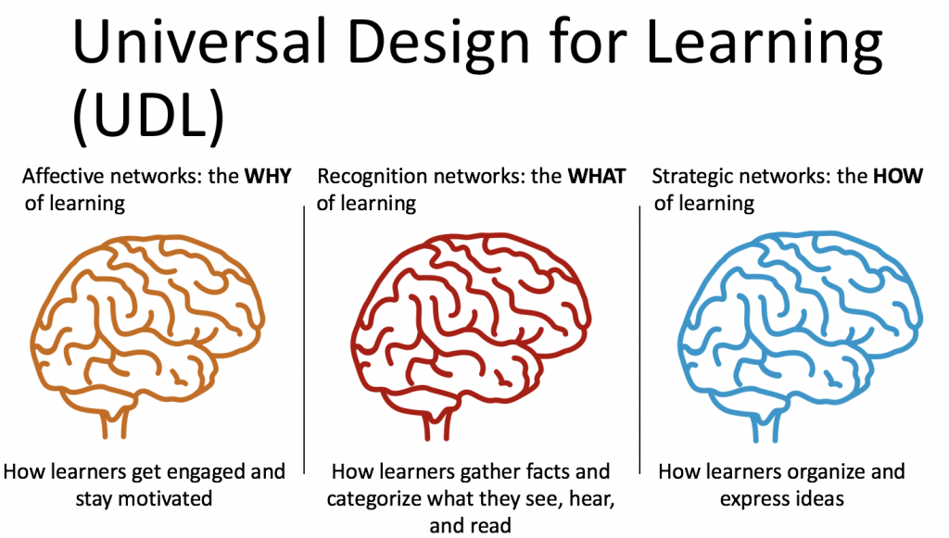
Layout of the UDL Framework
https://udlguidelines.cast.org/
This Photo by Unknown Author is licensed under CC BY-NC-ND

Slide 4
UDL Project: Individual or with others
UDL Project Options
Individual (1) | 5 considerations in total | At least 1 in each network, remaining 2 your choice
Partners (2) | 6 considerations in total | 2 in each network
Trios (3) | 7 considerations in total | 2 in each network, remaining 1 your choice
Quads (4) | 10 considerations in total | 3 in each network, remaining 1 your choice

Slide 5
Deliverables
1. Choose One:
Teaching Material: This is the item used to teach your students a concept. Examples are graphic organizer, textbook, video, podcast, etc.…
Assessment: This is the item used to measure what the student has learned, such as a quiz/test/worksheet/project.
Lesson Plan: Use the suggested Lesson Planner, Step I of Planner is required.
2. Include the Project Alignment Form

Slide 6
UDL Alignment Form
UDL Guideline Alignment Form
UDL Checkpoint (List by number) | Evidence of Alignment (Explain how checkpoint is aligned)
Example: 1.1 -The use of the Ed Psych Modules eBook (Durwin & Reese-Weber) for this class is a teaching material. | The text in the eBook can be customized for type of font, font size, and background page color. The read out loud feature is controlled by the student who can adjust the rate of speech and volume of speech.
1.
2.
3.
4.
5.

Slide 7

Lesson Plan template
Downloadable UDL lesson planner

Slide 8
Project Resources
Project Resources
Here instructor indicates where to locate project resources

