Slide 1
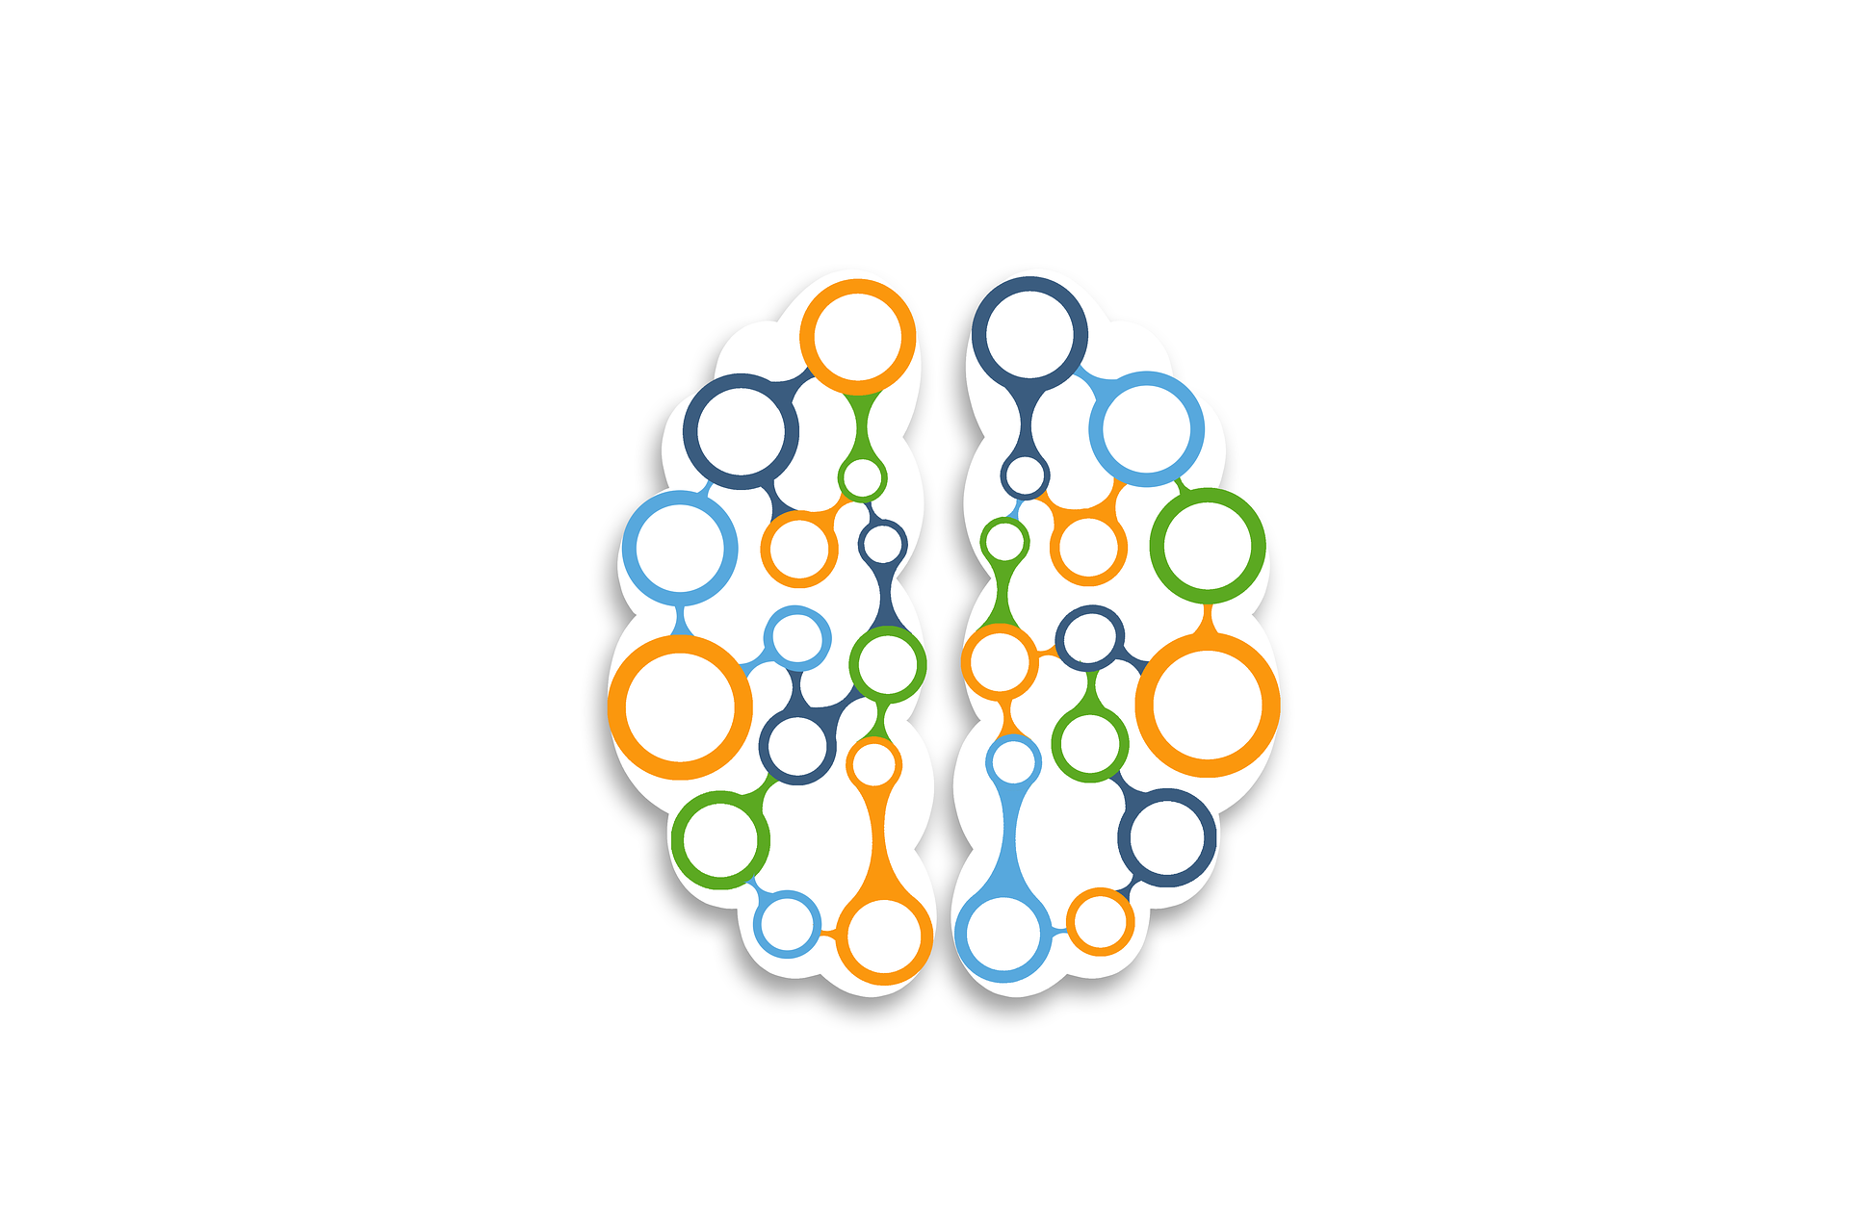
UDL: A Paradigm Shift in How We Teach
Presenters: Lynn L. Coffey and Kelli Hutton

Slide 2
Learner Outcomes
Understand the 3 brain networks to apply in your own teaching practice.
Successfully navigate the UDL Matrix (UDL framework)
Apply specific evidence-based learning strategies with your students.
Increase your comprehension of becoming an expert learner.

Slide 3
UDL: A Paradigm Shift in How We Teach
UDL Assumptions
Expert Learner
Learning Sciences

Slide 4
UDL: Putting it All Together
The Primary Assumptions in the UDL Approach are:
Variability exists in all learners
All learners can develop their own expertise in their own learing
UDL Assumptions
Expert Learner
Learning Sciences

Slide 5
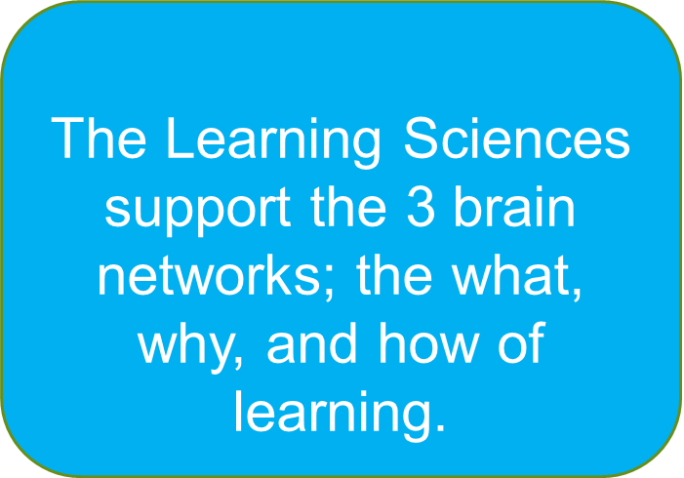
UDL: Bringing it All Together
https://udlguidelines.cast.org/
UDL Assumptions
Expert Learner
Learning Sciences
The 3 Brain Networks of UDL

Slide 6
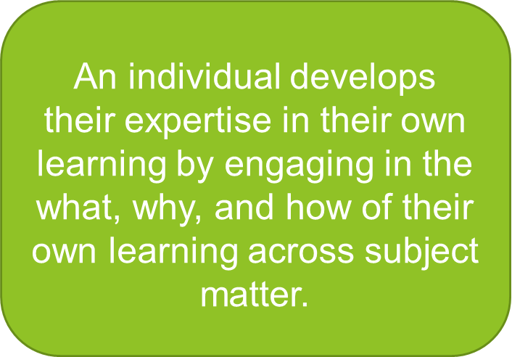
UDL: Bringing it All Together
The UDL Matrix
UDL Assumptions
Helpful video to understand the UDL Matrix
Expert Learner
Learning Sciences
5 Tips for the Expert Learner

Slide 7
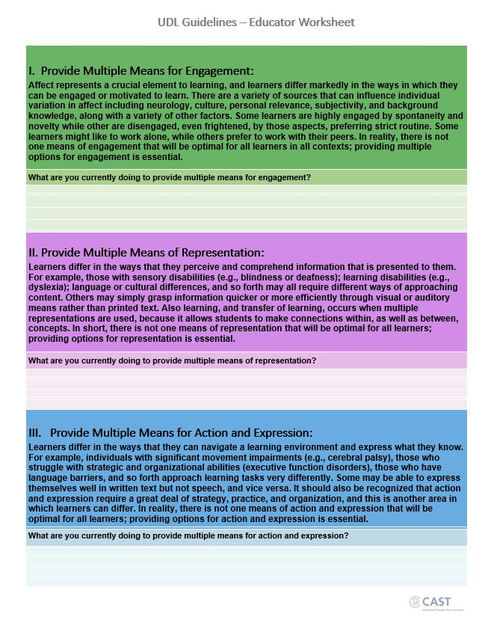
What might you implement in your class?

